Slide 1
NETWORK DESIGN
Logistics Management
Antony Paulraj
June 11, 2019

Slide 2
Agenda
Supply chain network design framework
Transportation Problems
  Network diagram
  Mathematical model formulation
  Solving using Excel
Transshipment Problems
  Network diagram
  Mathematical model formulation
  Solving using Excel
Group Exercise

Slide 3
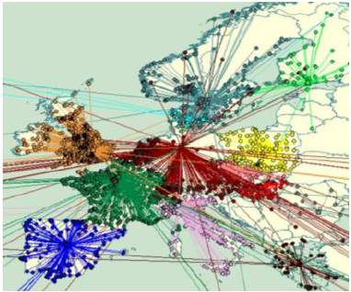
Supply Chain Network Design
Improving System Efficiency
Optimizing logistics network
  Optimizing network nodal points and inter-related transport flows.

Slide 4
Supply Chain Network Design
Improving System Efficiency
Optimizing logistics network
  Typical studies show that restructuring the logistics network could result in 11% cost reduction and a 10% reduction in emissions.
  Transport network restructuring
    24% of goods vehicle kms in Europe are running empty
    When carrying load, vehicles are typically only 57% loaded as a percentage of maximum gross weight.

Slide 5
Supply Chain Network Design Decisions
Facility role
  What role, what processes?
Facility location
  Where should facilities be located?
Capacity allocation
  How much capacity at each facility?
Market and supply allocation
  What markets? Which supply sources?

Slide 6

Factors Influencing
SC Network Design Decisions
What are the factors that affect Network Design?

Slide 7
Factors Influencing
SC Network Design Decisions
Strategic factors
Technological factors
Macroeconomic factors
  Tariffs and tax incentives
  Exchange-rate and demand risk
  Freight and fuel costs
Political

Slide 8
Factors Influencing
SC Network Design Decisions
Infrastructure factors
Competitive factors
  Positive externalities between firms
  Locating to split the market
Customer response time and local presence
Logistics and facility costs

Slide 9
Factors Influencing
SC Network Design Decisions - Costs
Production costs
Packaging costs
Transportation costs
Inventory costs
Warehousing costs
Information system costs
Lost sales cost

Slide 10
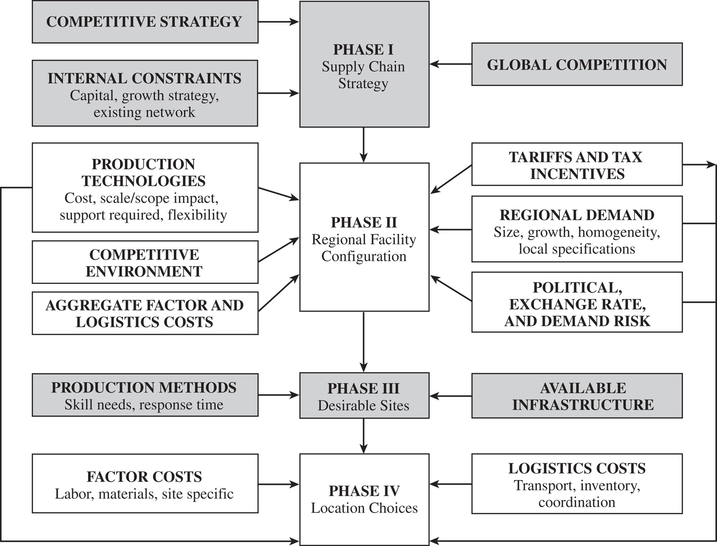
Framework
Supply Chain Network Design Decisions
Chopra & Meindl (2014), “Supply Chain Management: Strategy, Planning, and Operation”, Pearson .

Slide 11
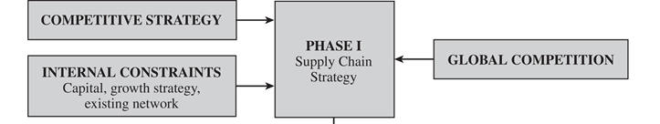
Framework
Supply Chain Network Design Decisions
Phase I: Define a Supply Chain Strategy/Design
  Clear definition of the firm’s competitive strategy
  Forecast the likely evolution of global competition
  Identify constraints on available capital
  Determine growth strategy

Slide 12
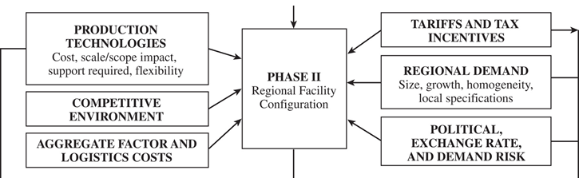
Framework
Supply Chain Network Design Decisions
Phase II: Define the Regional Facility Configuration
  Forecast of the demand by country or region
  Economies of scale or scope
  Identify demand risk, exchange-rate risk, political risk, tariffs, requirements for local production, tax incentives, and export or import restrictions
  Identify competitors

Slide 13
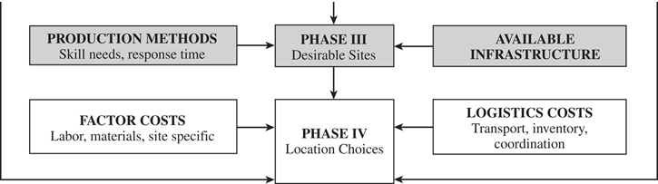
Framework
Supply Chain Network Design Decisions
Phase III: Select a Set of Desirable Potential Sites
  Hard infrastructure requirements
  Soft infrastructure requirements
Phase IV: Location Choices

Slide 14
Supply Chain Network Design
Network optimization models
  Linear programming models
  (mathematical programming)
Heuristics
Simulation
Simulation and optimization models are widely used.

Slide 15
NETWORK OPTIMIZATION MODELS
Transportation models
Transshipment models

Slide 16
The Transportation Model: Characteristics
A product is transported from a number of sources to a number of destinations at the minimum possible cost.
Each source is able to supply a fixed number of units of the product, and each destination has a fixed demand for the product.
The linear programming model has constraints for supply at each source and demand at each destination.
All constraints are equalities in a balanced transportation model where supply equals demand.
Constraints contain inequalities in unbalanced models where supply does not equal demand.

Slide 17
Transportation Model
Problem Definition and Data
How many tons of wheat to transport from each grain elevator to each mill on a monthly basis in order to minimize the total cost of transportation?
Grain Elevator Supply Mill Demand
1. Kansas City 150 A. Chicago 200
2. Omaha 175 B. St. Louis 100
3. Des Moines 275 C. Cincinnati 300
Total 600 tons Total 600 tons

Slide 18
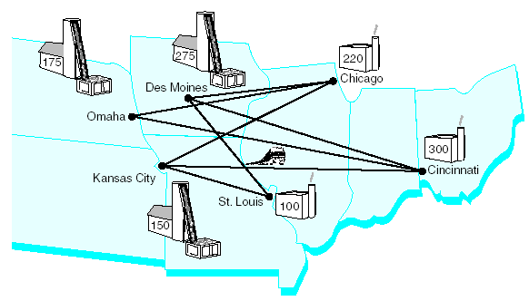
Transportation Model
Transportation Network Routes
Network of Transportation Routes for Wheat Shipments

Slide 19
Transportation Model
Model Formulation
Minimize Z = $6x_{1A} + 8x_{1B} + 10x_{1C} + 7x_{2A} + 11x_{2B} + 11x_{2C} + 4x_{3A} + 5x_{3B} + 12x_{3C}
subject to:
x_{1A} + x_{1B} + x_{1C} = 150
x_{2A} + x_{2B} + x_{2C} = 175
x_{3A} + x_{3B} + x_{3C} = 275
x_{1A} + x_{2A} + x_{3A} = 200
x_{1B} + x_{2B} + x_{3B} = 100
x_{1C} + x_{2C} + x_{3C} = 300
x_{ij} ≥ 0
x_{ij} = tons of wheat from each grain elevator, i, i = 1, 2, 3,
to each mill j, j = A,B,C

Slide 20
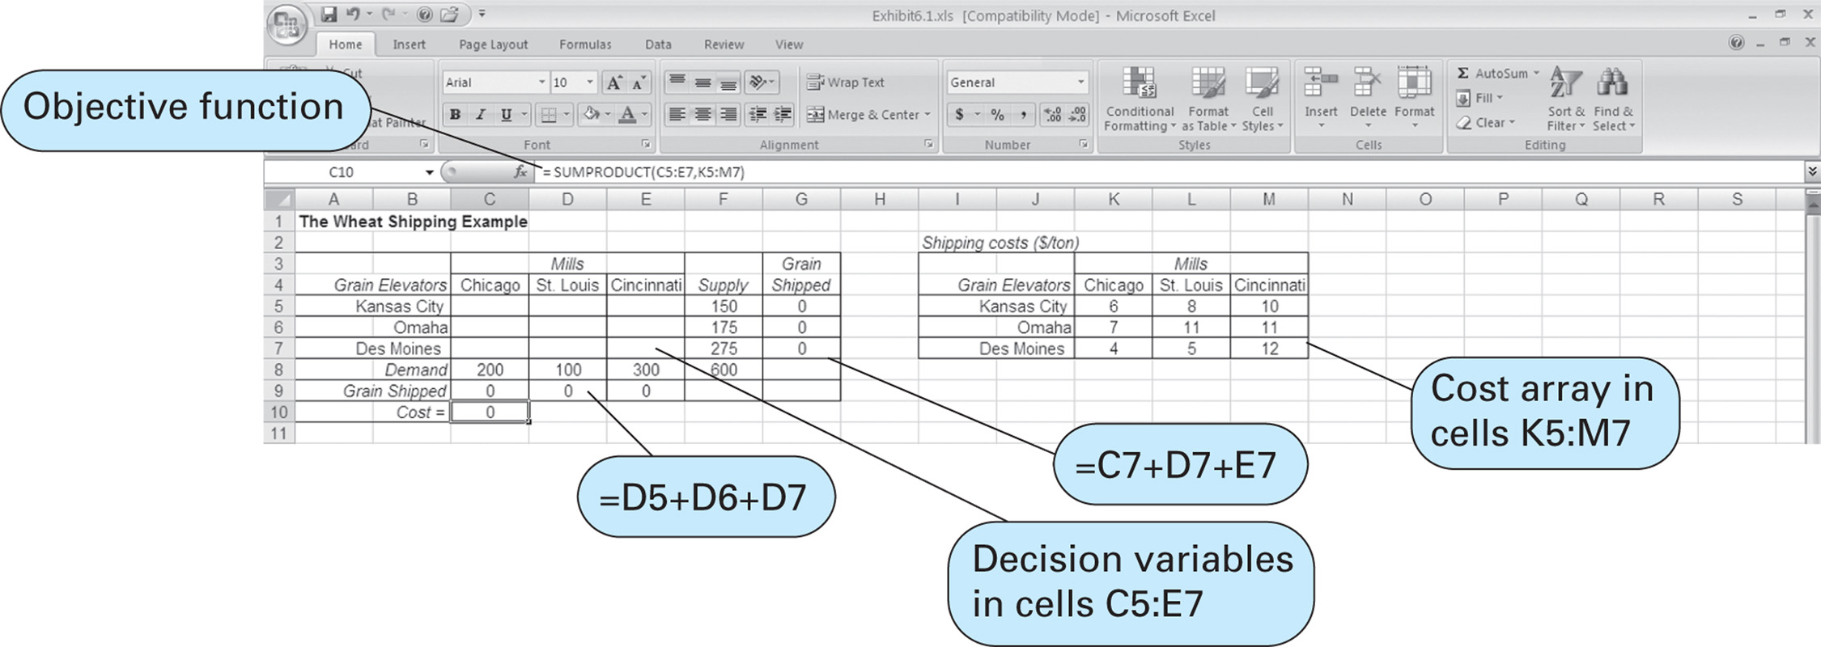
Transportation Model
Computer Solution – 1 of 4

Slide 21
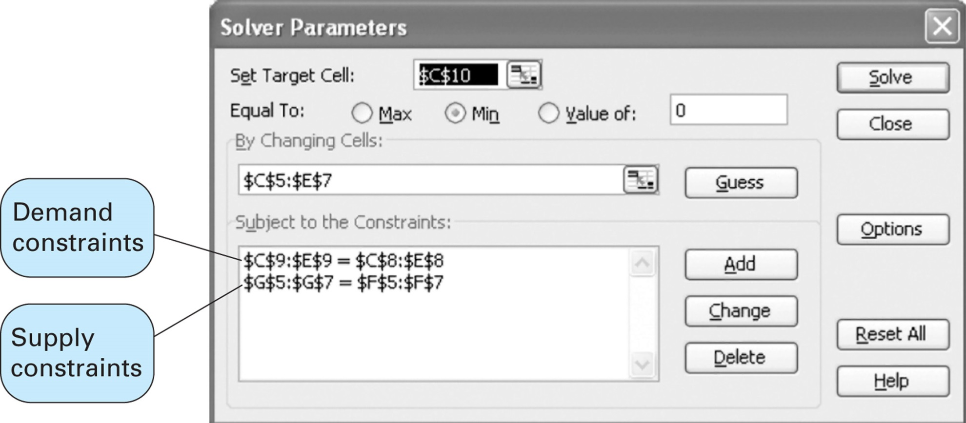
Transportation Model
Computer Solution – 2 of 4

Slide 22
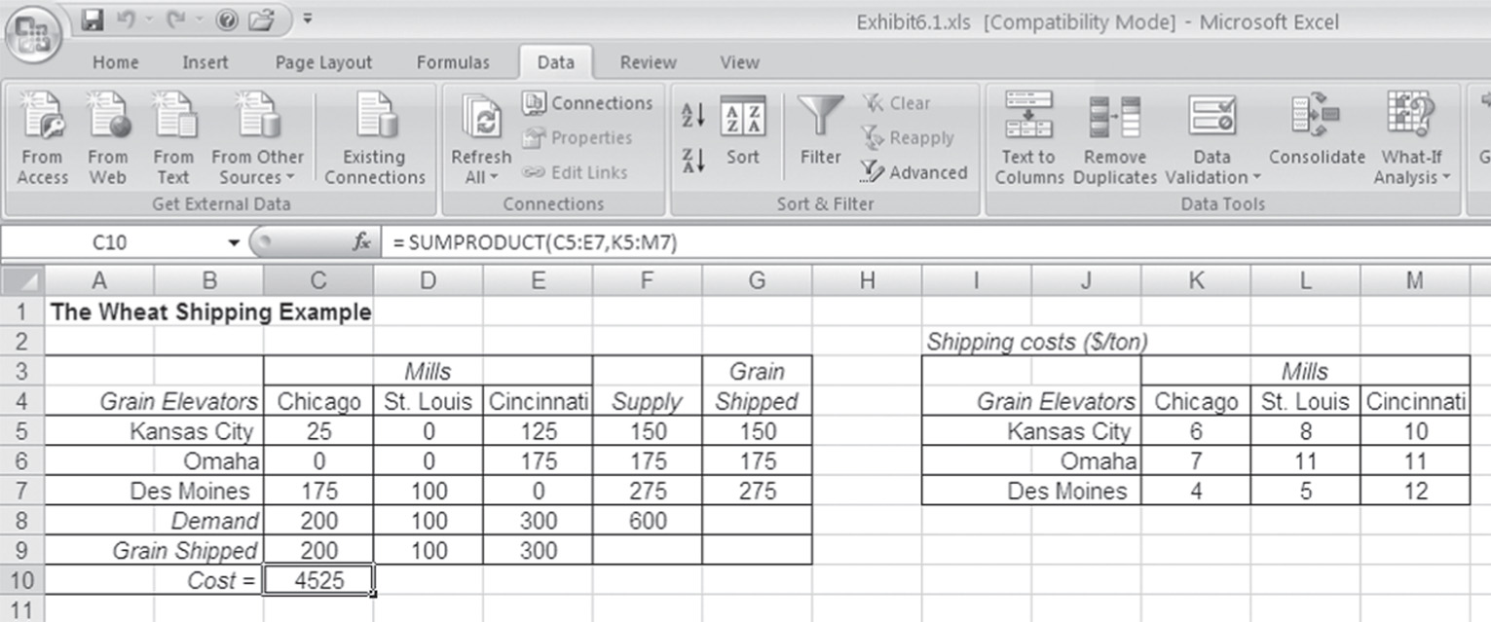
Transportation Model
Computer Solution – 3 of 4

Slide 23
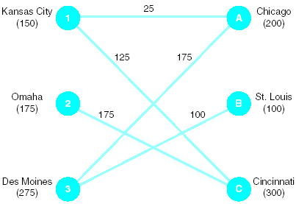
Transportation Model
Computer Solution – 4 of 4
Transportation Network Solution

Slide 24
Transportation Model
Problem 2
Formulate the following transportation problem and solve:

Slide 25
Transportation Model
Problem 2 – Model Formulation
Minimize Z = $8x_{1A} + 5x_{1B} + 6x_{1C} + 15x_{2A} + 10x_{2B} + 12x_{2C}
+3x_{3A} + 9x_{3B} + 10x_{3C}
subject to:
x_{1A} + x_{1B} + x_{1C} = 120
x_{2A} + x_{2B} + x_{2C} = 80
x_{3A} + x_{3B} + x_{3C} = 80
x_{1A} + x_{2A} + x_{3A} ≤ 150
x_{1B} + x_{2B} + x_{3B} ≤ 70
x_{1C} + x_{2C} + x_{3C} ≤ 100
x_{ij} ≥ 0

Slide 26
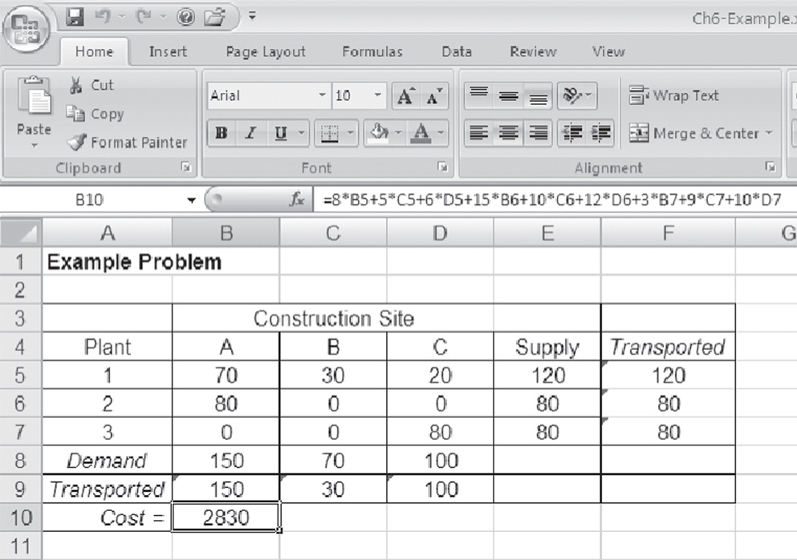
Transportation Model
Problem 2 – Computer Solution

Slide 27
Transportation Model
Problem 3
The US Pharmaceutical Company has four factories supplying the warehouses of four major customers and its management wants to determine the minimum-cost shipping schedule for its monthly output to these customers. Factory supply, warehouse demands, and shipping costs per case for these drugs are given below:
Factory Supply Warehouse Demand
Indianapolis 15 Columbus 10
Phoenix 6 St. Louis 12
New York 14 Denver 15
Atlanta 11 Los Angeles 9

Slide 28
The Transshipment Model: Characteristics
Extension of the transportation model.
Intermediate transshipment points are added between the sources and destinations.
Items may be transported from:
  Sources through transshipment points to destinations
  One source to another
  One transshipment point to another
  One destination to another
  Directly from sources to destinations
  Some combination of these
T₁
S₁
D₁
S₂
T₂

Slide 29
Transshipment Model
Extending this problem …
Network of Transportation Routes for Wheat Shipments

Slide 30
Transshipment Model
Problem Definition and Data
Extension of the transportation model in which intermediate transshipment points are added between sources and destinations.
Shipping Costs
1. Nebraska
2. Colorado
Farm Supply
1. Nebraska 300
2. Colorado 300
Total 600 tons

Slide 31
Transshipment Model
Problem Definition and Data
How many tons of wheat to transport from each grain elevator to each mill on a monthly basis in order to minimize the total cost of transportation?
Grain Elevator Mill Demand
1. Kansas City A. Chicago 220
2. Omaha B. St. Louis 100
3. Des Moines C. Cincinnati 300
Total 600 tons

Slide 32
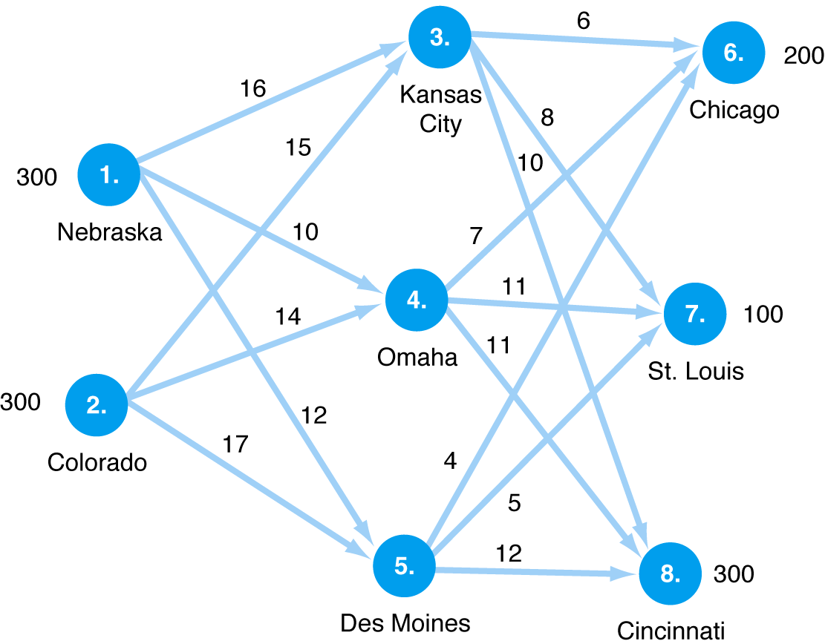
Transshipment Model
Transshipment Network Routes
Network of Transshipment Routes

Slide 33
Transshipment Model
Model Formulation
Minimize Z = $16x₁₃ + 10x₁₄ + 12x₁₅ + 15x₂₃ + 14x₂₄
+ 17x₂₅ + 6x₃₆ + 8x₃₇ + 10x₃₈ + 7x₄₆ + 11x₄₇
+ 11x₄₈ + 4x₅₆ + 5x₅₇ + 12x₅₈
subject to:
x₁₃ + x₁₄ + x₁₅ = 300
x₂₃ + x₂₄ + x₂₅ = 300
x₃₆ + x₄₆ + x₅₆ = 200
x₃₇ + x₄₇ + x₅₇ = 100
x₃₈ + x₄₈ + x₅₈ = 300
x₁₃ + x₂₃ - x₃₆ - x₃₇ - x₃₈ = 0
x₁₄ + x₂₄ - x₄₆ - x₄₇ - x₄₈ = 0
x₁₅ + x₂₅ - x₅₆ - x₅₇ - x₅₈ = 0
x_{ij} ≥ 0

Slide 34
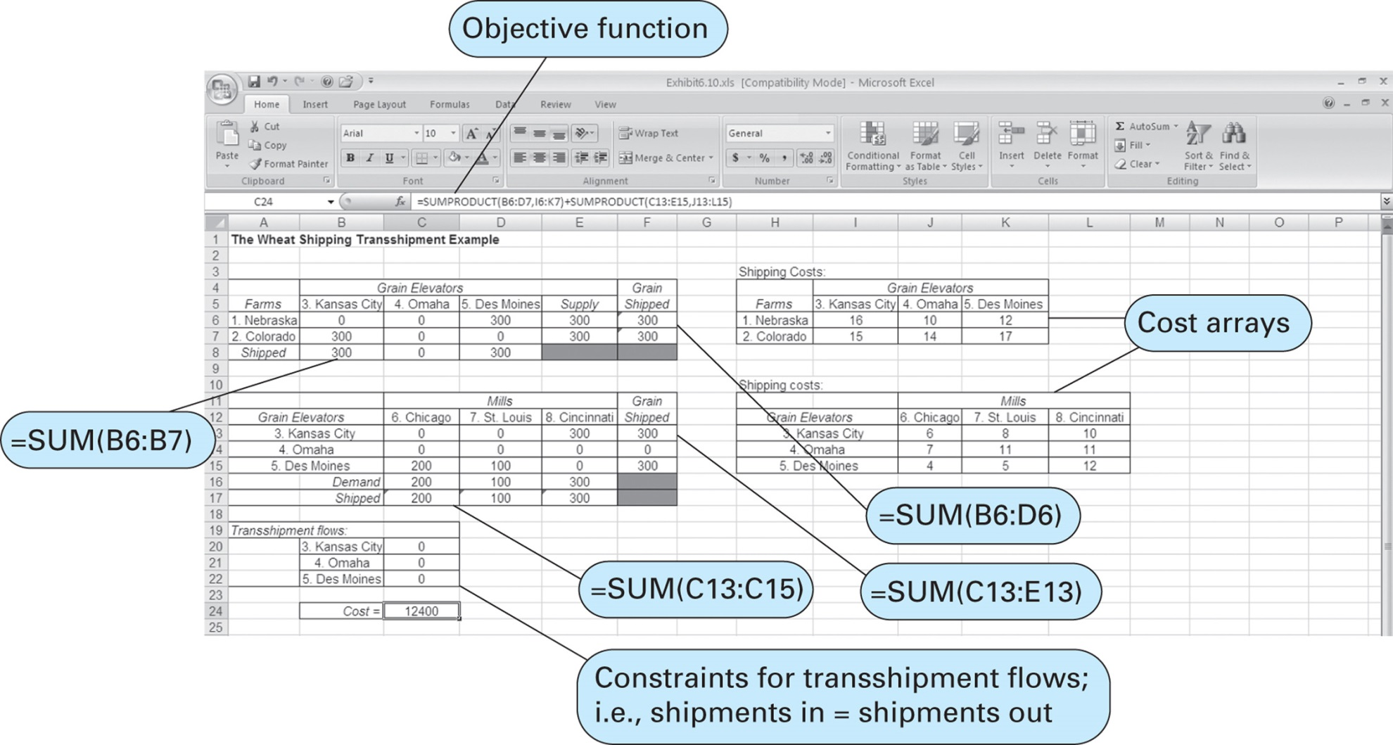
Transshipment Model
Computer Solution – 1 of 3

Slide 35
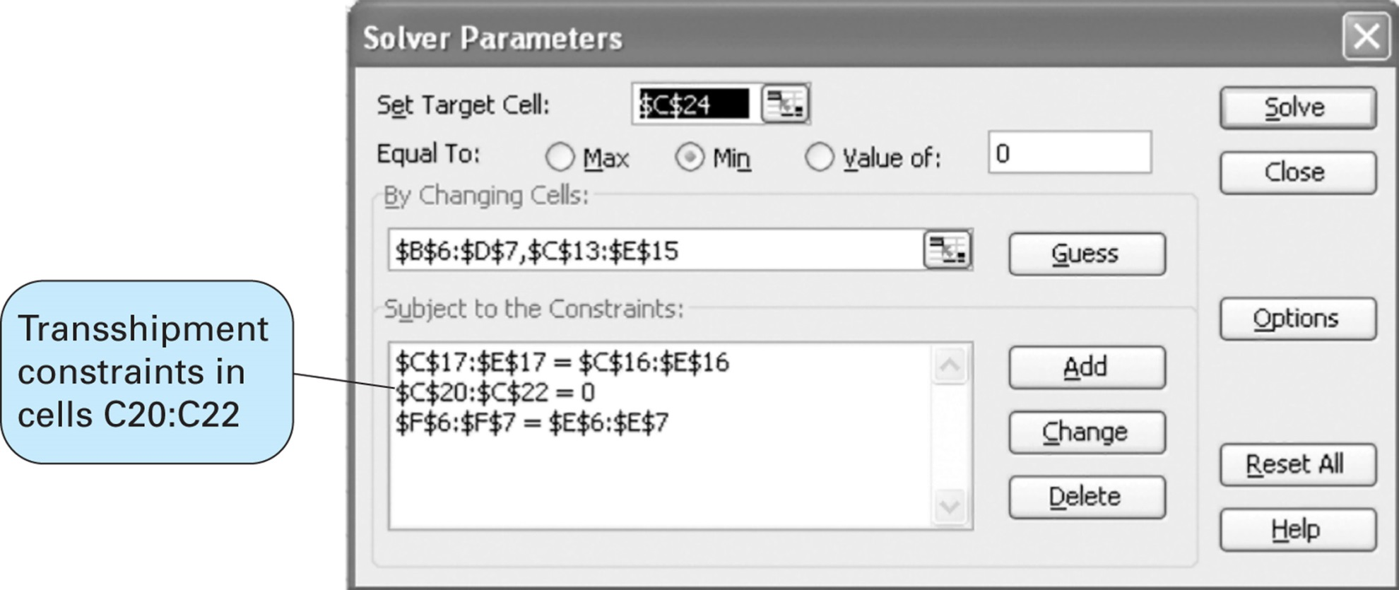
Transshipment Model
Computer Solution – 2 of 3

Slide 36
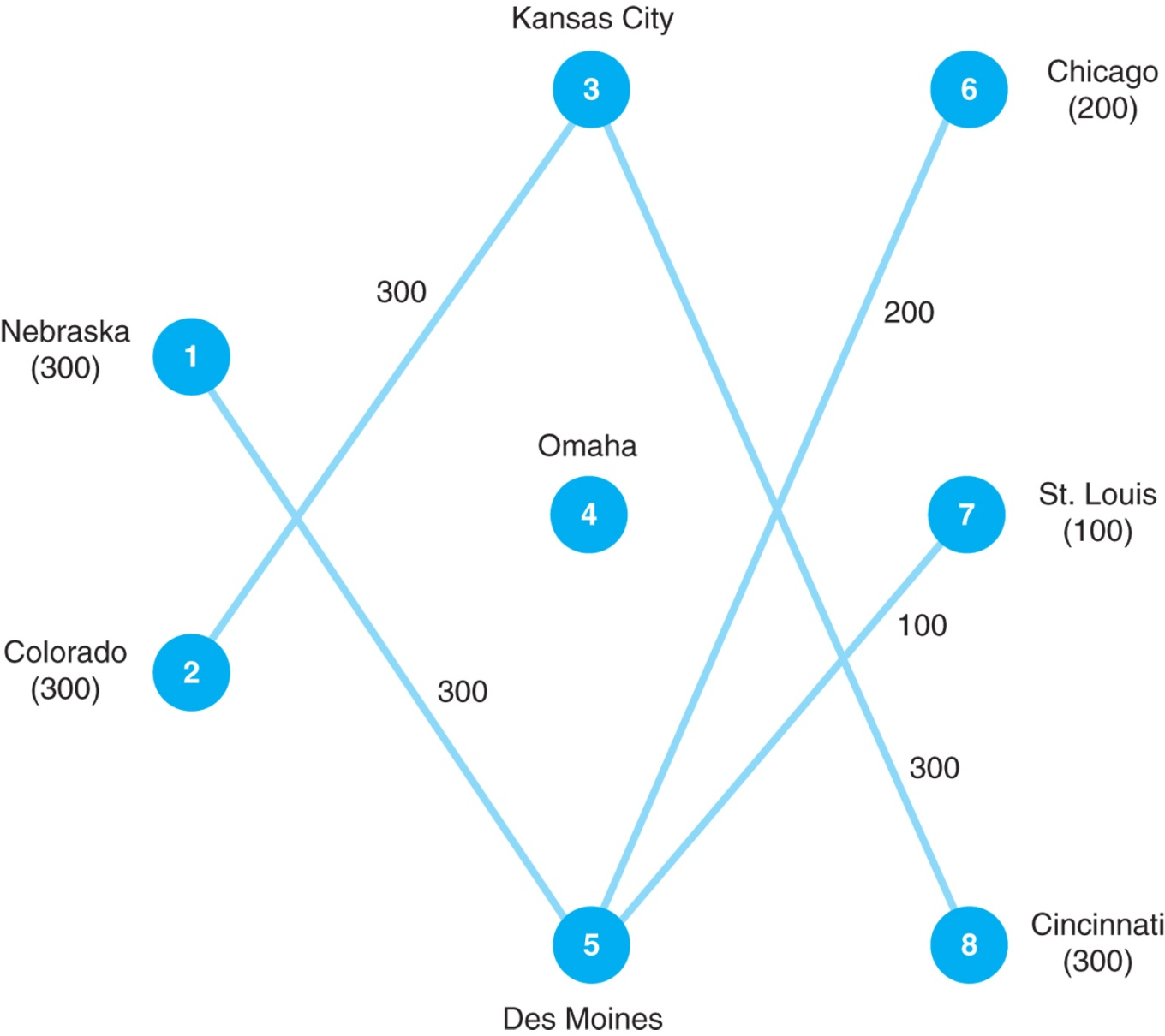
Transshipment Model
Computer Solution – 3 of 3

Slide 37
Transshipment Model
Problem 2
Adirondack Paper Mills Inc., has paper plants in Augusta, Maine, and Tupper Lake, New York. Warehouse facilities are located in Albany, New York, and Portsmouth, New Hampshire. Distributors are located in Boston, New York, and Philadelphia. The plant capacities and distributor demands for next month are as follows:

Slide 38
Transportation Model
Problem 2
The unit transportation costs ($) for shipments from the two plants to the two warehouses and from the two warehouses to the three distributors are as follows. Determine the minimum-cost shipping schedule for the problem.

Slide 39
Group Exercise

Slide 40
Darby
Distribution System Design

