Slide 1
RESOURCE PLANNING
Operations Management
Antony Paulraj
March 31, 2020

Slide 2
Resource Planning
At the heart of any organization
Starts with sales and operations plans and plans the input requirements
A process relative to the firm’s competitive priorities and an important part of managing supply chains

Slide 3
Enterprise Resource Planning
Back-Office Processes Front-Office Processes
Data Analysis
Product costing
Job costs
Human
Resources
Benefits
Payroll
Sales and Marketing
Sales orders
Pricing system
Manufacturing
Material requirements planning
Scheduling
ERP System
Accounting and Finance
Accounts payable and receivable
General ledgers
Asset management
Customer Service
Field service
Quality
Supply-Chain
Management
Forecasting
Purchasing
Distribution
Notes:
2

Slide 4
Materials Requirements Planning
MRP is a computerized information system to manage dependent demand inventory and schedule orders
Translates the master production schedule into requirements for all subassemblies, components, and raw materials through the MRP explosion
Dependent demand
Quantity required varies with the production plans of other items
Component
Parent

Slide 5
MRP Inputs
Authorized
master production
schedule
Other
sources
of demand
Inventory
transactions
Inventory
records
MRP
explosion
Bills of
materials
Engineering
and process
designs
Material
requirements
plan

Slide 6
Demand Patterns
2000 –
1500 –
1000 –
500 –
0
2000 –
1500 –
1000 –
500 –
0
Order
1000 on
day 3
Order
1000 on
day 8
Bicycles
Rims
Reorder point
| | | | | | | | | |
1 5 10
Day
| | | | | | | | | |
1 5 10
Day
(a) Parent inventory
(b) Component demand
Lumpy Dependent Demand Resulting from Continuous Independent Demand

Slide 7
Bill of Materials
A record of all components of an item
Shows the parent-component relationship
The usage quantities are derived from engineering and process design
Some common terms
End items
Intermediate items
Subassemblies
Purchased items
Part commonality (sometimes called standardization of parts or modularity)

Slide 8
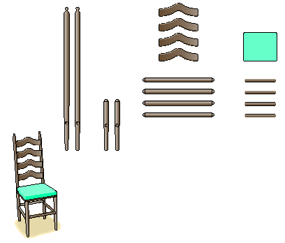
Bill of Materials
Back slats
Seat cushion
Leg supports
Seat-frame boards
Back legs
Front legs
A
Ladder-back chair

Slide 9
Bill of Materials
A
Ladder-back
chair
B (1)
Ladder-back
subassembly
C (2)
Seat
subassembly
D (2)
Front
legs
E (4)
Leg
supports
F (2)
Back legs
G (4)
Back slats
H (1)
Seat frame
I (1)
Seat cushion
J (4)
Seat-frame boards
BOM for a Ladder-Back Chair

Slide 10
Master Production Schedule (MPS)
Details how many end items will be produced within specified periods of time
It breaks the sales and operations plan into specific product schedules
Create a prospective MPS and test whether it meets the schedule with available resources
Sums of quantities must equal sales and operational plan
Production must be allocated efficiently over time
Capacity limitations and bottlenecks may be determined

Slide 11
Master Production Schedule (MPS)
 | April |  |  |  | May
 | 1 | 2 | 3 | 4 | 5 | 6 | 7 | 8
Ladder-back chair
Kitchen chair
Desk chair
Aggregate production plans for chair family
150
150
120
120
200
200
200
200
670
670

Slide 12
Developing a MPS
Step 1: Calculate projected on-hand inventories
Projected on-hand inventory at end of this week
On-hand inventory at end of last week
MPS quantity due at start of this week
Projected requirements this week
=
+
–
where:
Projected requirements = max(Forecast, Customer orders booked)
55 chairs currently in stock
MPS quantity (0 for week 1)
38 chairs already promised for delivery in week 1
Inventory
=
+
–
= 17 chairs

Slide 13
Developing a MPS
Item: Ladder-back chair
April
Quantity on Hand:
55
Explanation:
Forecast is less than booked orders in week 1; projected on-hand inventory balance = 55 + 0 – 38 = 17.
1
2
Forecast
30
30
Customer orders (booked)
38
27
Explanation:
Forecast exceeds booked orders in week 2; projected on-hand inventory balance = 17 + 0 – 30 = –13. The shortage signals a need to schedule an MPS quantity for completion in week 2.
Projected on-hand inventory
17
–13
MPS quantity
0
0
MPS start
Master Production Schedule for Weeks 1 and 2

Slide 14
Developing a MPS
Step 2: Determine the timing and size of MPS quantities
The goal is to maintain a nonnegative projected on-hand inventory balance
As shortages are detected, MPS quantities should be scheduled to cover them
17 chairs in inventory at the end of week 1
MPS quantity of 150 chairs
Forecast of 30 chairs
Inventory
=
+
–
= 137 chairs

Slide 15
Application 15.1
Determine the MPS for Product A that has a 50-unit policy and 5 units on hand. The demand forecast and booked orders are shown in the partially completed plan given in the Student Notes. The lead time is one week. Here is the completed plan. You might want to ask a question or two on how they would respond to a customer request for a specific week and order quantity.

Slide 16
Application 15.1
SOLUTION
Item: Product A | Order Policy: 50 units
 |  |  |  |  |  |  | Lead Time: 1 week
Quantity on Hand 5 | 1 | 2 | 3 | 4 | 5 | 6 | 7 | 8 | 9 | 10
Forecast | 20 | 10 | 40 | 10 | 0 | 0 | 30 | 20 | 40 | 20
Customer orders (booked) | 30 | 20 | 5 | 8 | 0 | 2 | 0 | 0 | 0 | 0
Projected on-hand inventory
MPS quantity
MPS start
Available-to-promise (ATP) inventory

Slide 17
Application 15.1
SOLUTION
Item: Product A | Order Policy: 50 units
 |  |  |  |  |  |  | Lead Time: 1 week
Quantity on Hand 5 | 1 | 2 | 3 | 4 | 5 | 6 | 7 | 8 | 9 | 10
Forecast | 20 | 10 | 40 | 10 | 0 | 0 | 30 | 20 | 40 | 20
Customer orders (booked) | 30 | 20 | 5 | 8 | 0 | 2 | 0 | 0 | 0 | 0
Projected on-hand inventory
MPS quantity
MPS start
Available-to-promise (ATP) inventory
 |  | 15
 | 50
 | 5 | 5 | 3 | 23 | 3 | 13 | 43
50 |  |  |  | 50 |  | 50 | 50
 |  |  | 50 |  | 50 | 50
35 |  |  |  | 50 |  | 50 | 50
25 | 5
50
5

Slide 18
Master Production Schedule (MPS)
Available-to-promise (ATP) inventory
The quantity of an end item that marketing can promise to deliver on specific dates
It is the difference between customer orders already booked and the quantity that operations is planning to produce
Freezing the MPS
Reconciling the MPS with sales and operations plans

Slide 19
Master Production Schedule (MPS)
Item: Ladder-back chair
Order Policy: 150 units
Lead Time: 1 week
April
May
Quantity on Hand:
55
1
2
3
4
5
6
7
8
Forecast
30
30
30
30
35
35
35
35
Customer orders booked
38
27
24
8
0
0
0
0
Projected on-hand inventory
17
137
107
77
42
7
122
87
MPS quantity
0
150
0
0
0
0
150
0
MPS start
150
0
0
0
0
150
0
0
Explanation:
The time needed to assemble 150 chairs is 1 week. The assembly department must start assembling chairs in week 1 to have them ready by week 2.
Explanation:
On-hand inventory balance = 17 + 150 – 30 = 137. The MPS quantity is needed to avoid a shortage of 30 – 17 = 13 chairs in week 2.

Slide 20
Master Production Schedule (MPS)
Item: Ladder-back chair
Order Policy: 150 units
Lead Time: 1 week
April
May
Quantity on Hand:
55
1
2
3
4
5
6
7
8
Forecast
30
30
30
30
35
35
35
35
Customer orders booked
38
27
24
8
0
0
0
0
Projected on-hand inventory
17
137
107
77
42
7
122
87
MPS quantity
0
150
0
0
0
0
150
0
MPS start
150
0
0
0
0
150
0
0
Available-to-promise (ATP) inventory
17
91
150
Explanation:
The total of customer orders booked until the next MPS receipt is 38 units. The ATP = 55 (on-hand) + 0 (MPS quantity) – 38 = 17.
Explanation:
The total of customer orders booked until the next MPS receipt is 27 + 24 + 8 = 59 units. The ATP = 150 (MPS quantity) – 59 = 91 units..
MPS Record with
an ATP Row

Slide 21
Materials Requirements Planning

Slide 22
Planning Factors
Planning lead time
For purchased items planning lead time is the time allowed for receiving a shipment from the supplier
For manufactured the planning lead time consists of estimates for
Setup time
Processing time
Materials handling time between operations
Waiting time

Slide 23
Planning Factors
Lot-sizing rules
L4L – Lot for lot
FOQ – Fixed order quantity
POQ – Periodic order quantity
Fixed order quantity (FOQ) rule maintains the same order quantity each time an order is issued
Could be determined by quantity discounts, truckload capacity, minimum purchases, or EOQ

Slide 24
Planning Factors
Periodic order quantity (POQ) rule allows a different order quantity for each order issue but tends to issue the order at predetermined time intervals
POQ lot size to arrive in week t
Total gross requirements for P week, including week t
Projected on-hand inventory balance at end of week t–1
=
–
Figure 15.12 shows the application of the POQ rule for P = 3

Slide 25
Planning Factors
The first order using P = 3 is
Gross requirements for weeks 4, 5, and 6
Inventory at end of week 3
(POQ lot size)
=
–
(POQ lot size) = (120 + 0 + 150) – 117 = 153 units

Slide 26
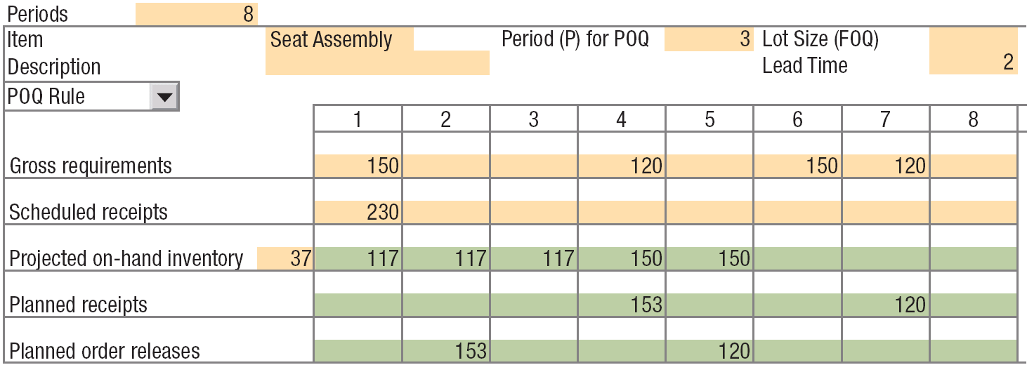
Planning Factors
The POQ (P = 3) Rule for the Seat Subassembly

Slide 27
Planning Factors
Lot-for-lot (L4L) rule where the lot size covers the gross requirements of a single week
L4L lot size to arrive in week t
Gross requirements for week t
Projected on-hand inventory balance at end of week t–1
=
–
Figure 15.13 shows the application of the L4L
(L4L lot size)
=
Gross requirements in week 4
–
Inventory balance at end of week 3
(L4L lot size) = 120 – 117 = 3 units

Slide 28
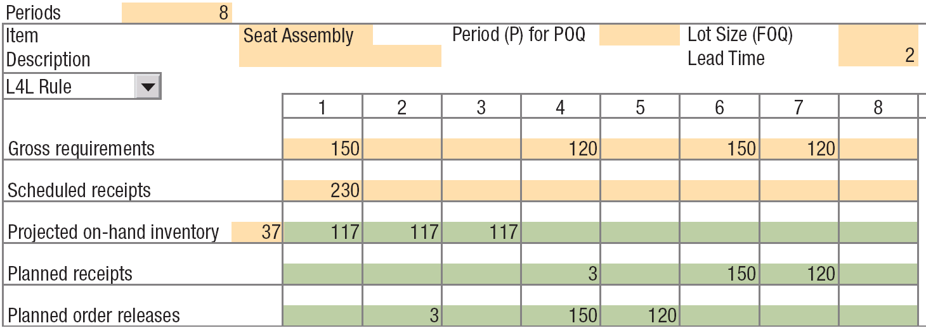
Planning Factors
Figure 15.13 – The L4L Rule for the Seat Subassembly

Slide 29
Application 15.2
Item H10-A is a produced item (not purchased) with an order quantity of 80 units. Complete the rest of its MRP record using the fixed order quantity (FOQ) rule
SOLUTION
Item: H10-A Description: Chair seat assembly |  |  |  |  |  |  | Lot Size: FOQ = 80 units Lead Time: 4 weeks
 | Week
 | 31 | 32 | 33 | 34 | 35 | 36 | 37 | 38 | 39 | 40
Gross requirements |  | 60 |  |  |  | 35 |  | 45 |  | 60
Scheduled receipts |  | 80
Projected on-hand inventory
Planned receipts
Planned order releases
20

Slide 30
Application 15.2
Item H10-A is a produced item (not purchased) with an order quantity of 80 units. Complete the rest of its MRP record using the fixed order quantity (FOQ) rule
SOLUTION
Item: H10-A Description: Chair seat assembly |  |  |  |  |  |  | Lot Size: FOQ = 80 units Lead Time: 4 weeks
 | Week
 | 31 | 32 | 33 | 34 | 35 | 36 | 37 | 38 | 39 | 40
Gross requirements |  | 60 |  |  |  | 35 |  | 45 |  | 60
Scheduled receipts |  | 80
Projected on-hand inventory
Planned receipts
Planned order releases
20 | 40 | 40 | 40 | 40 | 5 | 5 | 40
20
 |  |  |  |  | 40 | 60
 |  |  |  | 80
80
 |  |  |  | 80
80

Slide 31
Application 15.3
Now complete the H10-A record using a POQ rule. The P should give an average lot size of 80 units. Assume the average weekly requirements are 20 units.
80
20
P = = 4 weeks

Slide 32
Application 15.3
SOLUTION
Item: H10-A Description: Chair seat assembly |  |  |  |  |  |  | Lot Size: POQ = 4 Lead Time: 4 weeks
 | Week
 | 31 | 32 | 33 | 34 | 35 | 36 | 37 | 38 | 39 | 40
Gross requirements |  | 60 |  |  |  | 35 |  | 45 |  | 60
Scheduled receipts |  | 80
Projected on-hand inventory
Planned receipts
Planned order releases
20

Slide 33
Application 15.3
SOLUTION
Item: H10-A Description: Chair seat assembly |  |  |  |  |  |  | Lot Size: POQ = 4 Lead Time: 4 weeks
 | Week
 | 31 | 32 | 33 | 34 | 35 | 36 | 37 | 38 | 39 | 40
Gross requirements |  | 60 |  |  |  | 35 |  | 45 |  | 60
Scheduled receipts |  | 80
Projected on-hand inventory
Planned receipts
Planned order releases
20 | 40 | 40 | 40 | 40 | 5 | 5 | 60
20
 |  |  |  |  | 60 | 0
 |  |  |  | 100
100

Slide 34
Application 15.4
Revise the H10-A record using the lot-for-lot (L4L) Rule. (Complete the highlighted section)
SOLUTION
Item: H10-A Description: Chair seat assembly |  |  |  |  |  |  | Lot Size: FOQ = 80 units Lead Time: 4 weeks
 | Week
 | 31 | 32 | 33 | 34 | 35 | 36 | 37 | 38 | 39 | 40
Gross requirements |  | 60 |  |  |  | 35 |  | 45 |  | 60
Scheduled receipts |  | 80
Projected on-hand inventory
Planned receipts
Planned order releases
20

Slide 35
Application 15.4
Revise the H10-A record using the lot-for-lot (L4L) Rule. (Complete the highlighted section)
SOLUTION
Item: H10-A Description: Chair seat assembly |  |  |  |  |  |  | Lot Size: FOQ = 80 units Lead Time: 4 weeks
 | Week
 | 31 | 32 | 33 | 34 | 35 | 36 | 37 | 38 | 39 | 40
Gross requirements |  | 60 |  |  |  | 35 |  | 45 |  | 60
Scheduled receipts |  | 80
Projected on-hand inventory
Planned receipts
Planned order releases
 |  |  | 0 | 0
 |  |  |  | 60
60
20
20 | 40 | 40 | 40 | 40 | 5 | 5 | 0
 |  |  |  | 40
40

Slide 36
Planning Factors
Comparing lot-sizing rules
227 + 227 + 77 + 187 + 187
5
FOQ:
= 181 units
150 + 150 + 0 + 0 + 0
5
POQ:
= 60 units
0 + 0 + 0 + 0 + 0
5
L4L:
= 0 units

Slide 37
Planning Factors
Lot sizes affect inventory costs and setup and ordering costs
The FOQ rule generates a high level of average inventory because it creates inventory remnants
The POQ rule reduces the amount of average on-hand inventory because it does a better job of matching order quantity to requirements
The L4L rule minimizes inventory investment, but it also maximizes the number of orders placed

Slide 38
Planning Factors
Safety stock for dependent demand items with lumpy demand (gross requirements) is helpful only when future gross requirements, the timing or size of scheduled receipts, and the amount of scrap that will be produced are certain
Safety stock is used for end items and purchased items to protect against fluctuating customer orders and unreliable suppliers

Slide 39
Planning Factors
Inventory Record for the Seat Subassembly Showing the Application of a Safety Stock

Slide 40
MRP Explosion
Translates the MPS and other sources of demand into the requirements needed for all of the subassemblies, components, and raw materials the firm needs to produce parent items
An item’s gross requirements are derived from three sources
The MPS for immediate parents that are end items
The planned order releases for parents below the MPS level
Any other requirements not originating in the MPS, such as the demand for replacement parts

Slide 41
Bill of Materials
A
Ladder-back
chair
B (1)
Ladder-back
subassembly
C (1)
Seat
subassembly
D (2)
Front
legs
E (4)
Leg
supports
F (2)
Back legs
G (4)
Back slats
H (1)
Seat frame
I (1)
Seat cushion
J (4)
Seat-frame boards
BOM for a Ladder-Back Chair

Slide 42
MRP Explosion
C(1)
Seat subassembly
H(1)
Seat frame
I(1)
Seat cushion
J(4)
Seat-frame boards
BOM for the Seat Subassembly

Slide 43
MRP Explosion
Item: Seat subassembly
Lot size: 230 units
Lead
time: 2 weeks
Week
1
2
3
4
5
6
7
8
Gross requirements
150
0
0
120
0
150
120
0
Scheduled receipts
230
0
0
0
0
0
0
0
Projected on-hand inventory
37
117
117
117
227
227
77
187
187
Planned receipts
230
230
Planned order releases
230
230
MRP Explosion of Seat Assembly Components
Notes:
The series starts with the MRP record for the end item.

Slide 44
MRP Explosion
Item: Seat subassembly
Lot size: 230 units
Lead
time: 2 weeks
Week
1
2
3
4
5
6
7
8
Gross requirements
150
0
0
120
0
150
120
0
Planned receipts
230
230
Planned order releases
230
230
MRP Explosion of Seat Assembly Components
Notes:
This is reduced to allow room for subsequent records. The middle of the record has been cut to allow space.
This slide advances automatically.

Slide 45
MRP Explosion
Item: Seat subassembly
Lot size: 230 units
Lead
time: 2 weeks
Week
1
2
3
4
5
6
7
8
Gross requirements
150
0
0
120
0
150
120
0
Planned receipts
230
230
Planned order releases
230
230
Item: Seat frames
Lot size: 300 units
Lead
time: 1 week
Item: Seat cushion
Lot size: L4L
Lead
time: 1 week
Week
Week
1
2
3
4
5
6
7
8
1
2
3
4
5
6
7
8
Gross requirements
Gross requirements
Scheduled receipts
0
300
0
0
0
0
0
0
Scheduled receipts
0
0
0
0
0
0
0
0
Projected on-hand inventory
40
Projected on-hand inventory
0
Planned receipts
Planned receipts
Planned order releases
Planned order releases
Notes:
These are the two records for level one items.

Slide 46
MRP Explosion
Item: Seat subassembly
Lot size: 230 units
Lead
time: 2 weeks
Week
1
2
3
4
5
6
7
8
Gross requirements
150
0
0
120
0
150
120
0
Planned receipts
230
230
Planned order releases
230
230
Usage quantity: 1
Usage quantity: 1
Item: Seat frames
Lot size: 300 units
Lead
time: 1 week
Item: Seat cushion
Lot size: L4L
Lead
time: 1 week
Week
Week
1
2
3
4
5
6
7
8
1
2
3
4
5
6
7
8
Gross requirements
0
230
Gross requirements
0
230
Scheduled receipts
0
300
0
0
0
0
0
0
Scheduled receipts
0
0
0
0
0
0
0
0
Projected on-hand inventory
40
Projected on-hand inventory
0
Planned receipts
Planned receipts
Planned order releases
Planned order releases
Notes:
These are the two records for level one items.

Slide 47
MRP Explosion
Item: Seat subassembly
Lot size: 230 units
Lead
time: 2 weeks
Week
1
2
3
4
5
6
7
8
Gross requirements
150
0
0
120
0
150
120
0
Planned receipts
230
230
Planned order releases
230
230
Usage quantity: 1
Usage quantity: 1
Item: Seat frames
Lot size: 300 units
Lead
time: 1 week
Item: Seat cushion
Lot size: L4L
Lead
time: 1 week
Week
Week
1
2
3
4
5
6
7
8
1
2
3
4
5
6
7
8
Gross requirements
0
230
0
0
230
Gross requirements
0
230
0
0
230
Scheduled receipts
0
300
0
0
0
0
0
0
Scheduled receipts
0
0
0
0
0
0
0
0
Projected on-hand inventory
40
Projected on-hand inventory
0
Planned receipts
Planned receipts
Planned order releases
Planned order releases
Notes:
These are the two records for level one items.

Slide 48
MRP Explosion
Item: Seat subassembly
Lot size: 230 units
Lead
time: 2 weeks
Week
1
2
3
4
5
6
7
8
Gross requirements
150
0
0
120
0
150
120
0
Planned receipts
230
230
Planned order releases
230
230
Item: Seat frames
Lot size: 300 units
Lead
time: 1 week
Item: Seat cushion
Lot size: L4L
Lead
time: 1 week
Week
Week
1
2
3
4
5
6
7
8
1
2
3
4
5
6
7
8
Gross requirements
0
230
0
0
230
0
0
0
Gross requirements
0
230
0
0
230
0
0
0
Scheduled receipts
0
300
0
0
0
0
0
0
Scheduled receipts
0
0
0
0
0
0
0
0
Projected on-hand inventory
40
40
110
110
110
180
180
180
180
Projected on-hand inventory
0
0
0
0
0
0
0
0
0
Planned receipts
300
Planned receipts
230
230
Planned order releases
300
Planned order releases
230
230
Notes:
These are the two records for level one items.

Slide 49
MRP Explosion
Item: Seat frames
Lot size: 300 units
Lead
time: 1 week
Item: Seat cushion
Lot size: L4L
Lead
time: 1 week
Week
Week
1
2
3
4
5
6
7
8
1
2
3
4
5
6
7
8
Gross requirements
0
230
0
0
230
0
0
0
Gross requirements
0
230
0
0
230
0
0
0
Planned receipts
300
Planned receipts
230
230
Planned order releases
300
Planned order releases
230
230
Item: Seat-frame boards
Lot size: 1500 units
Lead
time: 1 week
Week
1
2
3
4
5
6
7
8
Gross requirements
Scheduled receipts
0
0
0
0
0
0
0
0
Projected on-hand inventory
200
Planned receipts
Planned order releases
Notes:
Once again, these are reduced and shortened for clarity.
This slide advances automatically.

Slide 50
MRP Explosion
Item: Seat frames
Lot size: 300 units
Lead
time: 1 week
Item: Seat cushion
Lot size: L4L
Lead
time: 1 week
Week
Week
1
2
3
4
5
6
7
8
1
2
3
4
5
6
7
8
Gross requirements
0
230
0
0
230
0
0
0
Gross requirements
0
230
0
0
230
0
0
0
Planned receipts
300
Planned receipts
230
230
Planned order releases
300
Planned order releases
230
230
Usage quantity: 4
Item: Seat-frame boards
Lot size: 1500 units
Lead
time: 1 week
Week
1
2
3
4
5
6
7
8
Gross requirements
0
0
0
1200
0
0
0
0
Scheduled receipts
0
0
0
0
0
0
0
0
Projected on-hand inventory
200
Planned receipts
Planned order releases
Notes:
Once again, these are reduced and shortened for clarity.
This slide advances automatically.

Slide 51
MRP Explosion
Item: Seat frames
Lot size: 300 units
Lead
time: 1 week
Item: Seat cushion
Lot size: L4L
Lead
time: 1 week
Week
Week
1
2
3
4
5
6
7
8
1
2
3
4
5
6
7
8
Gross requirements
0
230
0
0
230
0
0
0
Gross requirements
0
230
0
0
230
0
0
0
Planned receipts
300
Planned receipts
230
230
Planned order releases
300
Planned order releases
230
230
Item: Seat-frame boards
Lot size: 1500 units
Lead
time: 1 week
Week
1
2
3
4
5
6
7
8
Gross requirements
0
0
0
1200
0
0
0
0
Scheduled receipts
0
0
0
0
0
0
0
0
Projected on-hand inventory
200
200
200
200
500
500
500
500
500
Planned receipts
1500
Planned order releases
1500
Notes:
Once again, these are reduced and shortened for clarity.
This slide advances automatically.

Slide 52
MRP and the Environment
Consumer and government concern about the deterioration of the natural environment has driven manufacturers to reengineer their processes to become more environmentally friendly
Companies can modify their MRP systems to help track these waste and plans for their disposal

Slide 53
Application 15.5
A firm makes a product (Item A) from three components (intermediate Items B and D, and purchased item C). The latest MPS for product A calls for completion of a 250-unit order in week 8, and its lead time is 2 weeks. The master schedule and bill of material for Product A are given below.
Item: End Item A | Lead Time: 2 wks
 | Week
 | 1 | 2 | 3 | 4 | 5 | 6 | 7 | 8
MPS quantity |  |  |  |  |  |  |  | 250
MPS start |  |  |  |  |  | 250

Slide 54
Application 15.5
Develop a material requirements plan for items B, C, and D, given the following inventory data. Blank MRP records are provided in the Student Notes, and the completed records are shown on the next slide.
A
B(1)
C(1)
D(2)
C(2)
B(1)
Data Category | Item
 | B | C | D
Lot-sizing rule | POQ (P = 5) | FOQ = 1000 | L4L
Lead time | 2 weeks | 1 week | 3 weeks
Scheduled receipts | None | 1000 (week 1) | None
Beginning inventory | 0 | 800 | 0
C(2)

Slide 55
Application 15.5
SOLUTION
An item’s gross requirements cannot be derived until all of its immediate parents are processed. Thus we must begin with Item D. Its only immediate parent is item A, and its planned “production plan” is shown by the MPS start row. Note the 2-for-1 usage quantity when deriving D’s gross requirements.
Item: D Lot Size: L4L Description: Lead Time: 3 weeks
 | Week
 | 1 | 2 | 3 | 4 | 5 | 6 | 7 | 8
Gross requirements |  |  |  |  |  | 500
Scheduled receipts
Projected on-hand inventory 0 | 0 | 0 | 0 | 0 | 0 | 0 | 0 | 0
Planned receipts |  |  |  |  |  | 500
Planned order releases |  |  | 500

Slide 56
Application 15.5
We can do item B next, because the planned “production quantities” for its two immediate parents (A and D) are known. Item C cannot be done yet, because one of its parents is item B, and its PORs are still unknown.
Item: B Lot Size: POQ = 5 Description: Lead Time: 3 weeks
 | Week
 | 1 | 2 | 3 | 4 | 5 | 6 | 7 | 8
Gross requirements
Scheduled receipts
Projected on-hand inventory 0 | 0 |  | 0 | 0 | 0 | 0 | 0 | 0
Planned receipts
Planned order releases

Slide 57
Application 15.5
We can do item B next, because the planned “production quantities” for its two immediate parents (A and D) are known. Item C cannot be done yet, because one of its parents is item B, and its PORs are still unknown.
Item: B Lot Size: POQ = 5 Description: Lead Time: 3 weeks
 | Week
 | 1 | 2 | 3 | 4 | 5 | 6 | 7 | 8
Gross requirements |  |  | 500 |  |  | 250
Scheduled receipts
Projected on-hand inventory 0 | 0 | 0 | 0 | 0 | 0 | 0 | 0 | 0
Planned receipts |  |  | 750
Planned order releases | 750

Slide 58
Application 15.5
Finally we can do Item C, because we now know the planned “production quantities” of both of its immediate parents (A and B). Note that the usage quantity for its parent B is 2-for-1.
Item: C Lot Size: 1000 Description: Lead Time: 1 week
 | Week
 | 1 | 2 | 3 | 4 | 5 | 6 | 7 | 8
Gross requirements | 1500 |  |  |  |  | 250
Scheduled receipts | 1000
Projected on-hand inventory 800 | 300 | 300 | 300 | 300 | 300 | 1050 | 1050 | 1050
Planned receipts |  |  |  |  | 1000
Planned order releases |  |  |  |  | 1000

Slide 59
Solved Problem 2
The order policy is to produce end item A in lots of 50 units. Using the data shown in Figure 15.20 and the FOQ lot-sizing rule, complete the projected on-hand inventory and MPS quantity rows. Then complete the MPS start row by offsetting the MPS quantities for the final assembly lead time. Finally, compute the available-to-promise inventory for item A. If in week 1 a customer requests a new order for 30 units of item A, when is the earliest date the entire order could be shipped?

Slide 60
Solved Problem 2
Item: A |  |  |  |  |  |  | Order Policy: 50 units Lead Time: 1 week
 | Week
 | 1 | 2 | 3 | 4 | 5 | 6 | 7 | 8 | 9 | 10
Forecast | 20 | 10 | 40 | 10 | 0 | 0 | 30 | 20 | 40 | 20
Customer orders (booked) | 30 | 20 | 5 | 8 | 0 | 2 | 0 | 0 | 0 | 0
Projected on-hand inventory | 25
MPS quantity | 50
MPS start
Available-to-promise (ATP) inventory
MPS Record for End Item A

Slide 61
Solved Problem 2
SOLUTION
The projected on-hand inventory for the second week is
Projected on-hand inventory at end of week 2
On-hand inventory in week 1
MPS quantity due in week 2
Requirements in week 2
=
+
–
= 25 + 0 – 20 = 5 units
where requirements are the larger of the forecast or actual customer orders booked for shipment during this period. No MPS quantity is required.
Without an MPS quantity in the third period, a shortage of item A will occur: 5 + 0 – 40 = –35. Therefore, an MPS quantity equal to the lot size of 50 must be scheduled for completion in the third period. Then the projected on-hand inventory for the third week will be 5 + 50 – 40 = 15.

Slide 62
Solved Problem 2
Figure 15.21 shows the projected on-hand inventories and MPS quantities that would result from completing the MPS calculations. The MPS start row is completed by simply shifting a copy of the MPS quantity row to the left by one column to account for the 1-week final assembly lead time. Also shown are the available-to-promise quantities. In week 1, the ATP is
Available-to- promise in week 1
On-hand quantity in week 1
MPS quantity in week 1
Orders booked up to week 3 when the next MPS arrives
=
+
–
= 5 + 50 – (30 + 20) = 5 units

Slide 63
Solved Problem 2
The ATP for the MPS quantity in week 3 is
Available-to- promise in week 3
MPS quantity in week 3
Orders booked up to week 7 when the next MPS arrives
=
–
= 50 – (5 + 8 + 0 + 2) = 35 units
The other ATPs equal their respective MPS quantities because no orders are booked for those weeks. As for the new order for 30 units in week 1, the earliest it can be shipped is week 3 because the ATP for week 1 is insufficient. If the customer accepts the delivery date of week 3, the ATP for week 1 will stay at 5 units and the ATP for week 3 will be reduced to 5 units. This acceptance allows the firm the flexibility to immediately satisfy an order for 5 units or less, if one comes in. When the MPS is updated next, the customer orders booked for week 3 would be increased to 35 to reflect the new order’s shipping date.

Slide 64
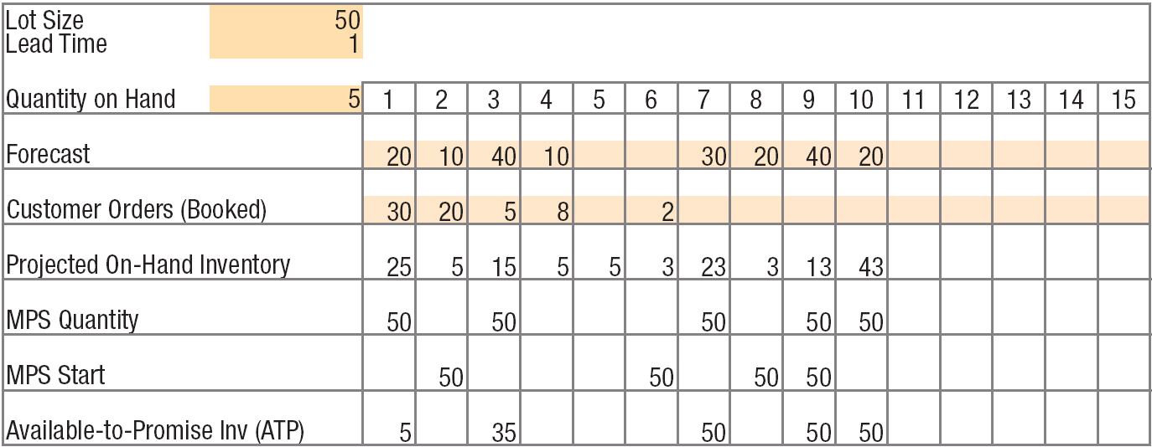
Solved Problem 2
Completed MPS Record for End Item A

Slide 65
Solved Problem 3
The MPS start quantities for product A calls for the assembly department to begin final assembly according to the following schedule: 100 units in week 2; 200 units in week 4; 120 units in week 6; 180 units in week 7; and 60 units in week 8. Develop a material requirements plan for the next 8 weeks for items B, C, and D. The BOM for A is shown in Figure 15.22, and data from the inventory records are shown in Table 15.1.
A
LT = 2
B (1)
C (2)
LT = 1
LT = 2
D (1)
LT = 3
BOM for Product A

Slide 66
Solved Problem 3
TABLE 15.1 | INVENTORY RECORD DATA
 |  | Item
Data Category | B | C | D
Lot-sizing rule | POQ (P=3) | L4L | FOQ = 500 units
Lead time | 1 week | 2 weeks | 3 weeks
Scheduled receipts | None | 200 (week 1) | None
Beginning (on-hand) inventory | 20 | 0 | 425
SOLUTION
We begin with items B and C and develop their inventory records, as shown in Figure 15.23. The MPS for product A must be multiplied by 2 to derive the gross requirements for item C because of the usage quantity. Once the planned order releases for item C are found, the gross requirements for item D can be calculated.

Slide 67
Solved Problem 3
Item: B |  |  |  |  |  |  | Lot Size: POQ (P = 3) Lead Time: 1 week
 | Week
 | 1 | 2 | 3 | 4 | 5 | 6 | 7 | 8 | 9 | 10
Gross requirements |  | 100 |  | 200 |  | 120 | 180 | 60
Scheduled receipts
Projected on-hand inventory | 20 | 200 | 200 | 0 | 0 | 240 | 60 | 0 | 0 | 0
Planned receipts |  | 280 |  |  |  | 360
Planned order releases | 280 |  |  |  | 360
20
Inventory Records for Items B, C, and D

Slide 68
Solved Problem 3
Item: C |  |  |  |  |  |  | Lot Size: L4L Lead Time: 2 weeks
 | Week
 | 1 | 2 | 3 | 4 | 5 | 6 | 7 | 8 | 9 | 10
Gross requirements |  | 200 |  | 400 |  | 240 | 360 | 120
Scheduled receipts | 200
Projected on-hand inventory | 200 | 0 | 0 | 0 | 0 | 0 | 0 | 0 | 0 | 0
Planned receipts |  |  |  | 400 |  | 240 | 360 | 120
Planned order releases |  | 400 |  | 240 | 360 | 120
0
Inventory Records for Items B, C, and D

Slide 69
Solved Problem 3
Item: D |  |  |  |  |  |  | Lot Size: FOQ =500 units Lead Time: 1 week
 | Week
 | 1 | 2 | 3 | 4 | 5 | 6 | 7 | 8 | 9 | 10
Gross requirements |  | 400 |  | 240 | 360 | 120
Scheduled receipts
Projected on-hand inventory | 425 | 25 | 25 | 285 | 425 | 305 | 305 | 305 | 305 | 305
Planned receipts |  |  |  | 500 | 500
Planned order releases | 500 | 500
425
Inventory Records for Items B, C, and D

