Slide 1
AGGREGATE PLANNING
Operations Management
Antony Paulraj
March 30, 2020

Slide 2
Operations planning and scheduling
Operations planning and scheduling is the process of making sure that demand and supply plans are in balance at all levels
Sales and operations planning and scheduling
Requires managerial inputs from many of the firm’s functions
Each function is affected by the plan

Slide 3
Operations planning and scheduling
TYPES OF PLANS WITH OPERATIONS PLANNING AND SCHEDULING
Term | Definition
Sales and operations plan (S&OP) | A time-phased plan of future aggregate resource levels so that supply is in balance with demand throughout the organization
Aggregate plan | Another term for the sales and operations plan
Production plan | A manufacturing firm’s sales and operations plan that centers on production rates and inventory holdings
Staffing plan | A sales and operations plan for a service firm, which centers on staffing and on other human resource-related factors
Resource plan | An intermediate, more detailed, step in the planning process that lies between S&OP and scheduling
Schedule | A detailed plan that allocates resources over shorter time horizons to accomplish specific tasks

Slide 4
Stages in Planning and Scheduling
Business or
annual plan
Operations
strategy
Sales and Operations Plan
Forecasting
Constraint
management
Sales
Plan
Operations
Plan
Resource Planning (services)
Resource Planning (manufacturing)
Workforce schedule
Materials and facility resources
Master production schedule
Material requirements planning
Scheduling
Scheduling
Employee schedules
Facility schedules
Customer schedules
Employee and equipment schedules
Production order schedules
Purchase order schedules

Slide 5
Managing Demand
Matching supply with demand becomes challenging when forecasts call for uneven demand patterns
Demand management, the process of changing demand patterns using one or more demand options

Slide 6
Managing Demand
DEMAND AND SUPPLY OPTIONS FOR OPERATIONS PLANNING AND SCHEDULING
Demand Options | Supply Options
Complementary products | Anticipation inventory
Promotional pricing | Workforce adjustment (hiring or layoffs)
Prescheduled appointments | Workforce utilization (overtime and undertime)
Reservations | Part-time workers and subcontractors
Revenue management | Vacation schedules
Backlogs | Workforce schedules
Backorders | Job and customer sequence
Stockouts | Expediting

Slide 7
Sales and Operations Plans
Operations
Distribution and marketing
Current machine capacities
Customer needs
Plans for future capacities
Demand forecasts
Workforce capacities
Competition behavior
Current staffing level
Materials
Accounting and finance
Supplier capabilities
Aggregate
Cost data
Storage capacity
plan
Financial condition
Materials availability
of firm
Engineering
Human resources
New products
Labor-market conditions
Product design changes
Training capacity
Machine standards
Notes:
15

Slide 8
Sales and Operations Plans
Information inputs
Supply options
Anticipation inventory
Workforce adjustment
Workforce utilization
Part-time workers
Subcontractors
Vacation schedules
Planning strategies
Chase strategy
Level strategy (with overtime)
Mixed strategy
Level strategy with anticipation inventory

Slide 9
Sales and Operations Plans
Constraints and costs
Six steps in the sales and operations planning process
TYPES OF COSTS WITH SALES AND OPERATIONS PLANNING
Cost | Definition
Regular time | Regular-time wages plus benefits and pay for vacations
Overtime | Wages paid for work beyond the normal workweek exclusive of fringe benefits
Hiring and layoff | Cost of advertising jobs, interviews, training programs, scrap caused by inexperienced employees, exit interviews, severance pay, and retraining
Inventory holding | Capital, storage and warehousing, pilferage and obsolescence, insurance, and taxes
Backorder and stockout | Costs to expedite past-due orders, potential cost of losing a customer

Slide 10
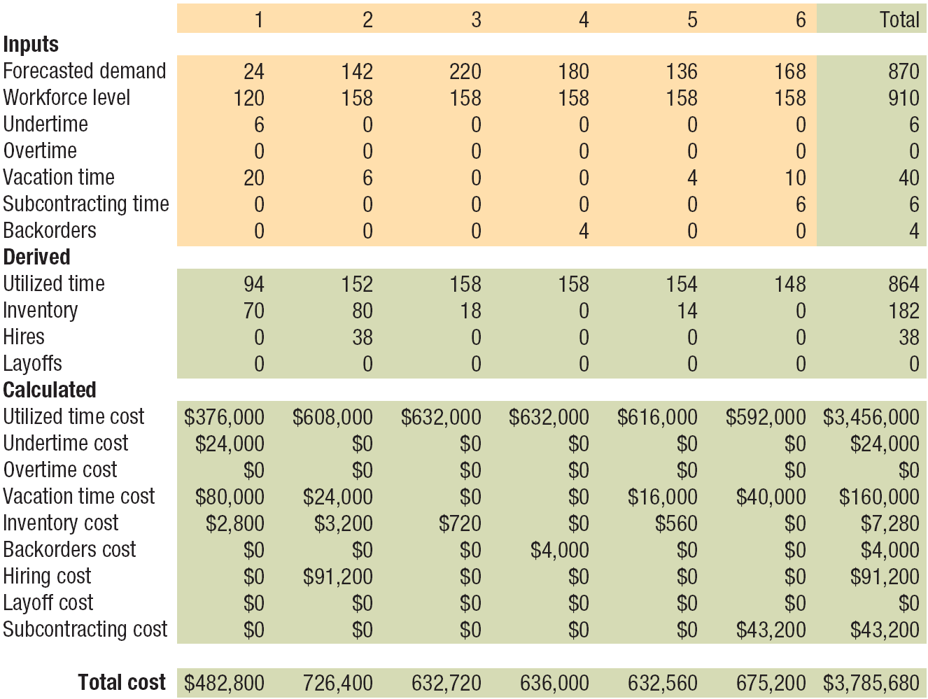
Using Spreadsheets

Slide 11
Using Chase and Level Strategies
EXAMPLE 1
A large distribution center must develop a staffing plan that minimizes total costs using part-time stockpickers
First level strategy that meets demand with the minimum use of undertime and not consider vacation scheduling
Each part-time employee can work a maximum of 20 hours per week on regular time
Instead of paying undertime, each worker’s day is shortened during slack periods and overtime can be used during peak periods
 | 1 | 2 | 3 | 4 | 5 | 6 | Total
Forecasted demand | 6 | 12 | 18 | 15 | 13 | 14 | 78

Slide 12
Using Chase and Level Strategies
Currently, 10 part-time clerks are employed. They have not been subtracted from the forecasted demand shown. Constraints and cost information are as follows:
a. The size of training facilities limits the number of new hires in any period to no more than 10.
b. No backorders are permitted.
c. Overtime cannot exceed 20 percent of the regular-time capacity in any period. The most that any part-time employee can work is 1.20(20) = 24 hours per week.
d. The following costs can be assigned:
Regular-time wage rate $2,000/time period at 20 hrs/week
Overtime wages 150% of the regular-time rate
Hires $1,000 per person
Layoffs $500 per person

Slide 13
Using Chase and Level Strategies
SOLUTION
a. Chase Strategy
This strategy simply involves adjusting the workforce as needed to meet demand, as shown in Figure 14.5. Rows in the spreadsheet that do not apply (such as inventory and vacations) are hidden. The workforce level row is identical to the forecasted demand row. A large number of hirings and layoffs begin with laying off 4 part-time employees immediately because the current staff is 10 and the staff level required in period 1 is only 6. However, many employees, such as college students, prefer part-time work. The total cost is $173,500, and most of the cost increase comes from frequent hiring and layoffs, which add $17,500 to the cost of utilized regular-time costs.

Slide 14
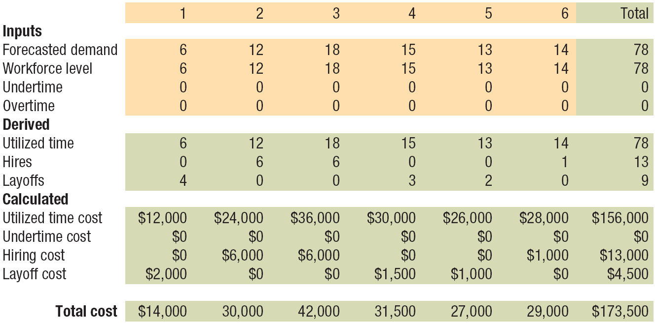
Using Chase and Level Strategies

Slide 15
Using Chase and Level Strategies
b. Level Strategy
In order to minimize undertime, the maximum use of overtime possible must occur in the peak period. For this particular level strategy (other workforce options are possible), the most overtime that the manager can use is 20 percent of the regular-time capacity, w, so
1.20w = 18 employees required in peak period (period 3)
18
1.20
w =
= 15 employees
A 15-employee staff size minimizes the amount of undertime for this level strategy. Because the staff already includes 10 part-time employees, the manager should immediately hire 5 more. The complete plan is shown in Figure 14.6. The total cost is $164,000.

Slide 16
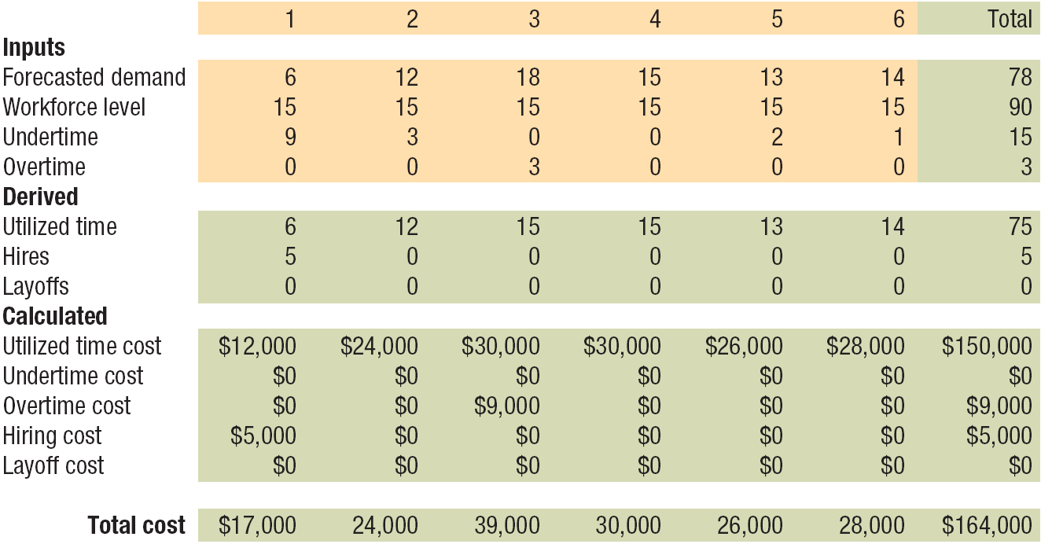
Using Chase and Level Strategies

Slide 17
Example 2
The Barberton Municipal Division of Road Maintenance is charged with road repair in the city of Barberton and surrounding area. Cindy Kramer, road maintenance director, must submit a staffing plan for the next year based on a set schedule for repairs and on the city budget. Kramer estimates that the labor hours required for the next four quarters are 6,000, 12,000, 19,000, and 9,000, respectively. Each of the 11 workers on the workforce can contribute 520 hours per quarter. Overtime is limited to 20 percent of the regular-time capacity in any quarter. Subcontracting is not permitted.
Payroll costs are $6,240 in wages per worker for regular time worked up to 520 hours, with an overtime pay rate of $18 for each overtime hour. Although unused overtime capacity has no cost, unused regular time is paid at $12 per hour. The cost of hiring a worker is $3,000, and the cost of laying off a worker is $2,000.

Slide 18
Example 2
Use a chase strategy for the Barberton Municipal Division that varies the workforce level without using overtime. Undertime should be minimized, except for the minimal amount mandated because the quarterly requirements are not integer multiples of 520 hours.

Slide 19
Example 2
 | Quarter
 | 1 | 2 | 3 | 4 | Total
Forecasted demand (hrs) | 6,000 | 12,000 | 19,000 | 9,000 | 46,000
Workforce level (workers) | 12 |  |  |  | 91
Undertime (hours) | 240 |  |  |  | 1,320
Overtime (hours) | 0 |  |  |  | 0
Utilized time (hours) | 6,000 |  |  |  | 46,000
Hires (workers) | 1 |  |  |  | 26
Layoffs (workers) | 0 |  |  |  | 19
24
480
0
12,000
12
0
37
240
0
19,000
13
0
18
360
0
9,000
0
19

Slide 20
Example 2
What is the total cost of this plan?
Costs per Quarter
 | 1 | 2 | 3 | 4 | Total
Utilized time | $72,000 |  |  |  | $552,000
Undertime | 2,880 |  |  |  | 15,840
Overtime | 0 |  |  |  | 0
Hires | 3,000 |  |  |  | 78,000
Layoffs | 0 |  |  |  | 38,000
 |  |  | Total Cost |  | $683,840
$144,000
5,760
0
36,000
0
$228,000
2,880
0
39,000
0
$108,000
4,320
0
0
38,000

Slide 21
Example 2
Find a level plan for the Barberton Municipal Division that allows no delay in road repair and minimizes undertime. Overtime can be used to its limits in any quarter. Given that the demand peaks in quarter 3, we get:
19,000
520
1.20w =
=
36.54 employee-period equivalents
w = 30.45 or 31 employees

Slide 22
Example 2
Quarter
 | 1 | 2 | 3 | 4 | Total
Forecasted demand (hrs) | 6,000 | 12,000 | 19,000 | 9,000 | 46,000
Workforce level (workers) | 31
Undertime (hours) | 10,120
Overtime (hours) | 0
Utilized time (hours) | 6,000
Hires (workers) | 20
Layoffs (workers) | 0
31
4,120
0
12,000
0
0
31
0
2,880
16,120
0
0
31
7,120
0
9,000
0
0
124
21,360
2,880
43,120
20
0

Slide 23
Example 2
What is the total cost of this level workforce plan?
Costs per Quarter
 | 1 | 2 | 3 | 4 | Total
Utilized time | $72,000 |  |  |  | $517,440
Undertime | 121,440 |  |  |  | 256,320
Overtime | 0 |  |  |  | 51,840
Hires | 60,000 |  |  |  | 60,000
Layoffs | 0 |  |  |  | 0
 |  |  | Total Cost |  | $885,600
$144,000
49,440
0
0
0
$193,440
0
51,840
0
0
$108,000
85,440
0
0
0

Slide 24
Example 2
A mixed strategy considers and implements a fuller range of reactive alternatives than any one “pure” strategy.
Now propose a plan of your own for the Barberton Municipal Division. Use the chase strategy as a base, but find a way to decrease the cost of hiring and layoffs by selectively using some overtime. (Students complete highlighted sections)

Slide 25
Example 2
Quarter
 | 1 | 2 | 3 | 4 | Total
Forecasted demand | 6,000 | 12,000 | 19,000 | 9,000 | 46,000
Workforce level
Undertime (hours)
Overtime (hours)
Utilized time (hours)
Hires (workers)
Layoffs (workers)
12
240
0
6,000
1
0
24
480
0
12,000
12
0
31
0
2,880
16,120
7
0
18
360
0
9,000
0
13
85
1,080
2,880
43,120
20
13
Several solutions are possible. The key idea in creating this one is hiring only 7 employees in quarter 3, while using overtime to its maximum limit and eliminating undertime for that quarter. Hiring fewer in quarter 3 allows the number of layoffs in quarter 4 to drop to only 13, down from 19.

Slide 26
Example 2
What is the cost of your mixed strategy plan?
Costs per Quarter
 | 1 | 2 | 3 | 4 | Total
Utilized time | $72,000 | $144,000 | $193,440 | $108,000 | $517,440
Undertime
Overtime
Hires
Layoffs
 |  |  | Total Cost
2,880
0
3,000
0
5,760
0
36,000
0
0
51,840
21,000
0
4,320
0
0
26,000
12,960
51,840
60,000
26,000
$668,240

Slide 27
Example 3
The Cranston Telephone Company employs workers who lay telephone cables and perform various other construction tasks. The company prides itself on good service and strives to complete all service orders within the planning period in which they are received.
Each worker puts in 600 hours of regular time per planning period and can work as many as an additional 100 hours of overtime. The operations department has estimated the following workforce requirements for such services over the next four planning periods:
Planning Period | 1 | 2 | 3 | 4
Demand (hours) | 21,000 | 18,000 | 30,000 | 12,000

Slide 28
Example 3
Cranston pays regular-time wages of $6,000 per employee per period for any time worked up to 600 hours (including undertime). The overtime pay rate is $15 per hour over 600 hours. Hiring, training, and outfitting a new employee costs $8,000. Layoff costs are $2,000 per employee. Currently, 40 employees work for Cranston in this capacity. No delays in service, or backorders, are allowed. Use the spreadsheet approach to answer the following questions:
a. Prepare a chase strategy using only hiring and layoffs. What are the total numbers of employees hired and laid off?
b. Develop a workforce plan that uses the level strategy, relaying only on overtime and undertime. Maximize the use of overtime during the peak period so as to minimize the workforce level and amount of undertime.
c. Propose an effective mixed-strategy plan.
d. Compare the total costs of the three plans.

Slide 29
Example 3
a. The chase strategy workforce is calculated by dividing the demand for each period by 600 hours, or the amount or regular-time work for one employee during one period. This strategy calls for a total of 20 workers to be hired and 40 to be laid off during the four-period plan. Figure 14.9 shows the “chase strategy” solution that OM Explorer’s Sales and Operations Planning with Spreadsheets solver produces. We simply hide any unneeded columns and rows in this general-purpose solver.

Slide 30
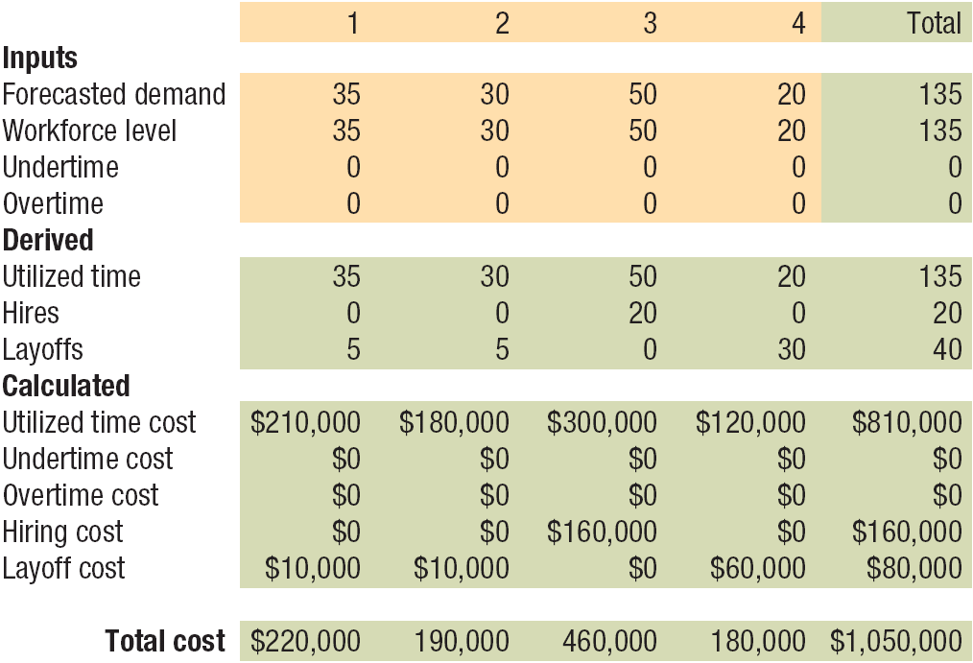
Example 3

Slide 31
Example 3
b. The peak demand is 30,000 hours in period 3. As each employee can work 700 hours per period (600 on regular time and 100 on overtime), the workforce level of the level strategy that minimizes undertime is 30,000/700 = 42.86, or 43 employees. This strategy calls for three employees to be hired in the first quarter and for none to be laid off. To convert the demand requirements into employee-period equivalents, divide the demand in hours by 600. For example, the demand of 21,000 hours in period 1 translates into 35 employee-period equivalents (21,000/600) and demand in period 3 translates into 50 employee-period equivalents (30,000/600). Figure 14.10 shows OM Explorer’s spreadsheet for this level strategy that minimizes undertime.

Slide 32
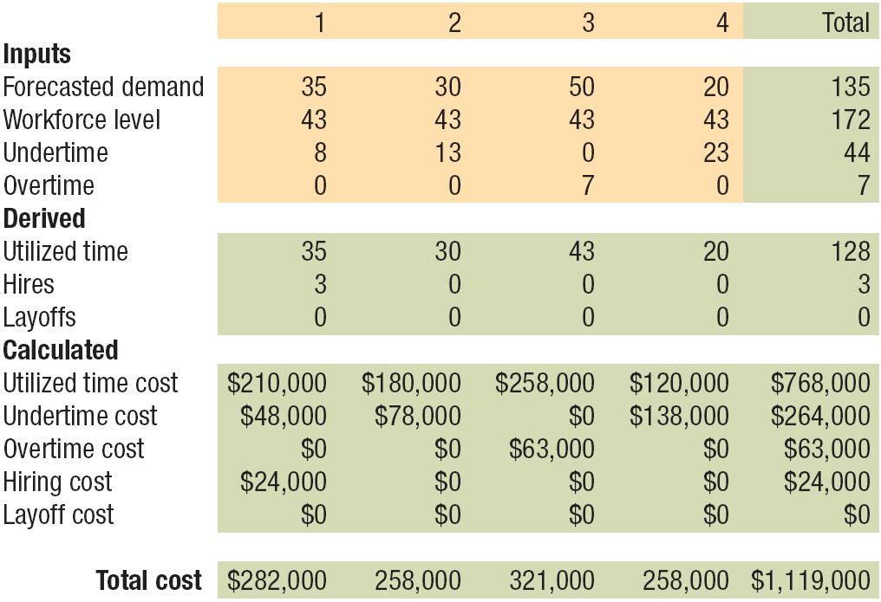
Example 3

Slide 33
Example 3
c. The mixed-strategy plan that we propose uses a combination of hires, layoffs, and overtime to reduce total costs. The workforce is reduced by 5 at the beginning of the first period, increased by 8 in the third period, and reduced by 13 in the fourth period. Figure 14.11 shows the results.

Slide 34
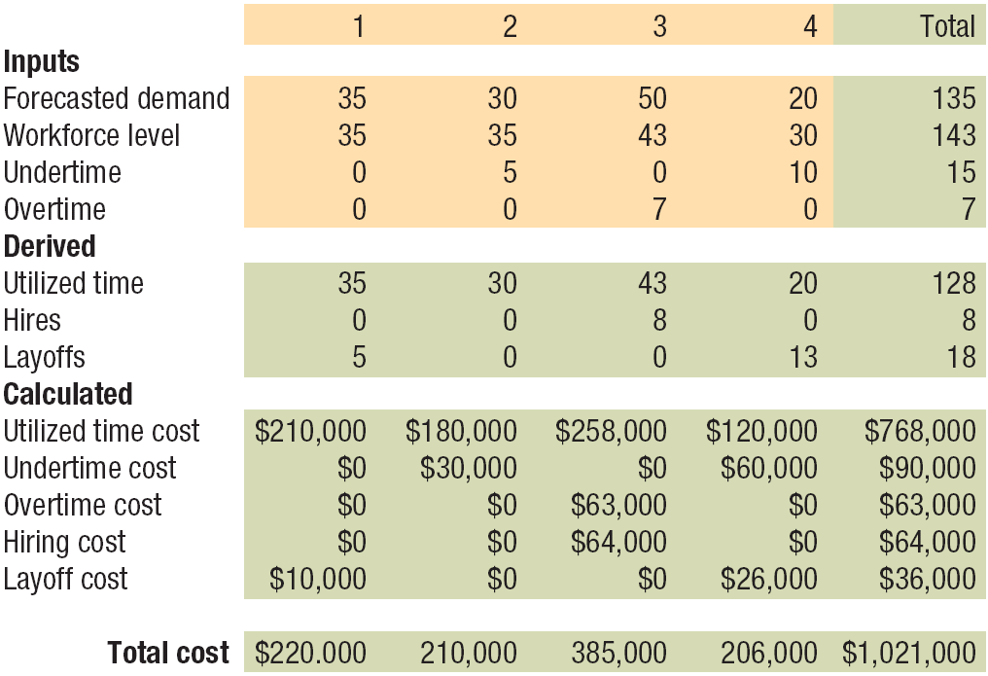
Example 3

Slide 35
Example 3
d. The total cost of the chase strategy is $1,050,000. The level strategy results in a total cost of $1,119,000. The mixed-strategy plan was developed by trial and error and results in a total cost of $1,021,000. Further improvements are possible.

