Slide 1
INTRODUCTION
Operations Management
Antony Paulraj
March 30, 2020

Slide 2
Background
Completed my Ph.D. from Cleveland State University, Ohio, USA.
Li Dak Sum Chair Professor in Operations Management, Nottingham University Business School – Ningbo, China
Professor in Operations and Supply Chain Management, Alliance Manchester Business School, University of Manchester, UK – September 2015 onwards
Worked in Denmark for 3 years before joining University of Manchester. Before this, taught in the USA for over 8 years.
Taught undergraduate, masters, MBA, Ph.D., and Executive MBA courses in the Belgium, Denmark, France, Italy, India, Sweden, and United Arab Emirates, United Kingdom, United States of America.
Notes:
2

Slide 3
Topics to be covered
Introduction to Operations Management
Forecasting
Aggregate Plan
Master Production Schedule
Materials Requirements Planning
Inventory / Quality Management

Slide 4
Taking a process perspective
Materials
Information
Products and services
Customers
Staff
Facilities
Transformation process
Notes:
What is operations and process management? And by extension, what is managing healthcare operations?
Ultimately, the objective of all operations to more effectively manage inputs (both transforming and transformed) to ensure better outputs.
All organisations have ‘operations’ because all organisations produce products, services, or a mix of both.
Tangible vs. intangible outcomes: intangible: haircut, consultant advise. Tangible: a personal computer or a tv.
Examples:
Some are materials that are transformed into cars. This is what most commonly comes to mind when we think of transformation.
A sandwich at McDonalds: bread, meat, source (materials), staff (preparing the food), this all is going to be transformed into burger.
Some transform patients bodies (Clinical processes); some transform patients minds (Psychotherapy); some transform staff (customers) (e.g. HR training processes); some transform materials and information to support the process

Slide 5
Across an organization …
Finance
Acquires financial resources and capital for inputs
Material & Service Inputs
Sales Revenue
Support Functions
Accounting
Information Systems
Human Resources
Engineering
Operations
Translates materials and service into outputs
Marketing
Generates sales of outputs
Product & Service Outputs
Notes:
What is operations and process management? And by extension, what is managing healthcare operations?
Ultimately, the objective of all operations to more effectively manage inputs (both transforming and transformed) to ensure better outputs.
All organisations have ‘operations’ because all organisations produce products, services, or a mix of both.
Tangible vs. intangible outcomes: intangible: haircut, consultant advise. Tangible: a personal computer or a tv.
Examples:
Some are materials that are transformed into cars. This is what most commonly comes to mind when we think of transformation.
A sandwich at McDonalds: bread, meat, source (materials), staff (preparing the food), this all is going to be transformed into burger.
Some transform patients bodies (Clinical processes); some transform patients minds (Psychotherapy); some transform staff (customers) (e.g. HR training processes); some transform materials and information to support the process

Slide 6
Production / Services
More like a manufacturing process
More like a service process
Physical, durable output
Output can be inventoried
Low customer contact
Long response time
Capital intensive
Quality easily measured
Intangible, perishable output
Output cannot be inventoried
High customer contact
Short response time
Labor intensive
Quality not easily measured

Slide 7
Missions and Strategies
Mission
Goals
Organizational strategy
Functional strategies
Finance
Operations
Marketing
Financial
Tactics
Operations
Tactics
Marketing
Tactics

Slide 8
Missions and Strategies
Corporate Strategy
Environmental scanning
Core competencies
Core processes
Global strategies
Market Analysis
Market segmentation
Needs assessment
Competitive Priorities
Cost
Quality
Time
Flexibility
New Service/
Product Development
Design
Analysis
Development
Full launch
No
Performance Gap?
Yes
Operations Strategy
Decisions
Managing processes
Managing supply chains
Competitive Capabilities
Current
Needed
Planned

Slide 9
Competitive Priorities (Performance Objectives)
Operations can provide competitive advantage through performance in…
Quality
Being RIGHT
Speed
Being FAST
Dependability
Being ON TIME
Flexibility
Being ABLE TO CHANGE
Cost
Being PRODUCTIVE

Slide 10
Relative Performance Objectives
Taxi service
Bus service
Cost
Speed
Dependability
Quality
Flexibility

Slide 11
The role of operations function
Operations
as implementer
Operations as supporter
Operations as driver
Strategy
Strategy
Strategy
Operations
Operations
Operations
Operations
Operations
Operations
implements strategy
supports strategy
drives strategy

Slide 12
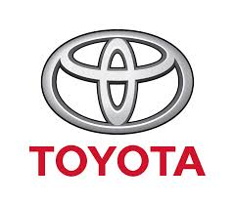
The role of operations function
Toyota – JIT as a competitive advantage
Zara – Lean with touches of agile
Low waste, no discounts
Suppliers closer to factories, which in turn are closer to consumers
Dell direct model – lean
Lean
No middle-man
Highly customisable

Slide 13
Example of a Supply Network: Dell Direct Model
Customer
Supplier a
Dell
Hub
Local suppliers
Supplier n
Notes:
Objective > Strategy > Supply Chain
What Dell wanted: produce computers cheaper than competitors and more customizable products.
How to create a supply chain to attain these two objectives?
Cut the middle man – computers sold directly to consumers
Reduce logistic costs by having an efficient (lean) supply chain, e.g. no inventories, etc.
Central idea: sell computers directly to consumers, cutting the middle man. The idea was to do that in the most efficient way.
Link strategy with supply chain.
When Dell started, this market was dominated by IBM, which had almost 50% of the market.
What is Dell’s business model? Cheap and customizable.
Strategy: increase velocity, reduce inventory and reduce the overall cost per machine.
No warehouse, suppliers elsewhere – how can this problem be equated? One, it created a hub – all manufacturers have to keep inventory very close to Dells plants. But that was not enough. The inventory kept was, on average for two weeks only, so not much. The other strategy was to use only trusted partners. If you carry only two weeks of inventory, you must trust that there will be no delays. That means trusting the manufacturers of parts and also the people delivering these parts. A parallel strategy was to have also local suppliers.
How Dell differs from, say, Apple? Cheaper.
Most of Dell’s suppliers keep components warehoused less than 20 minutes away from Dell’s factory.
The only component that is kept in large numbers in inventory is interl’s microprocessors.
To be customizable, do you need to have your factories far or close to your consumers? Remember that it takes 6 weeks to ship something from China to the UK, for instance. Close, right?
What is the problem of being too close to the consumers? In other words, why don’t Dell produce everything and buy all components in the UK? Yes, cost. How can that be averted? It may been to compromise, e.g. have its factories in Poland. Labor is not as cheap as its is in China, but it is close.
Another way to save money is to have no inventory, right? How to do I that? In the case of Dell, the suppliers hold two weeks worth of inventory for them. So supplier A, for instance, keeps inventory in a Hub, close to a factory if Dell.
One thing that you quickly realize when studying supply chains is that they are not really chains, but rather networks.

Slide 14
Operations strategy at Walmart

Slide 15
Order winners and order qualifiers
Positive
order winners
less important
Neutral
Competitive benefit
qualifiers
Negative
Low
High
Achieved performance

Slide 16
Trends in Operations Management
Productivity improvement
Global competition
Ethical, workforce, and environmental issues
Industry 4.0 – Smart manufacturing

Slide 17
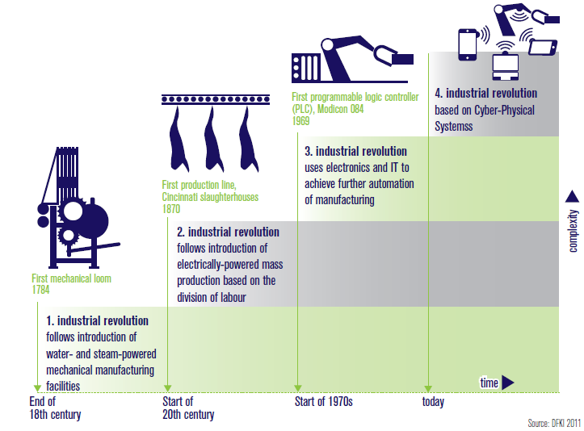
The stages of industrial revolution
Notes:
17

Slide 18
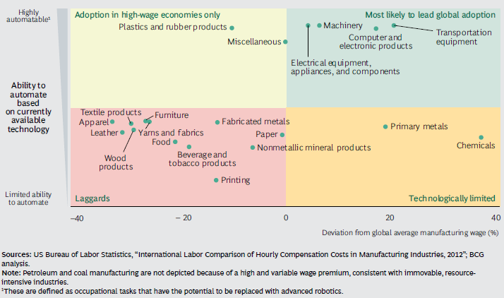
Adoption of Robotics

Slide 19
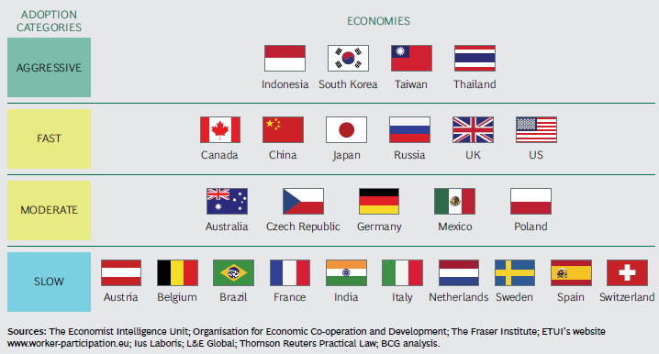
Adoption of Robotics

Slide 20
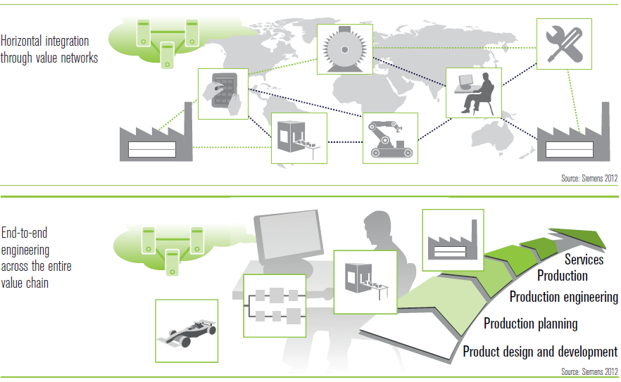
Integration
Notes:
What is operations and process management? And by extension, what is managing healthcare operations?
Ultimately, the objective of all operations to more effectively manage inputs (both transforming and transformed) to ensure better outputs.
All organisations have ‘operations’ because all organisations produce products, services, or a mix of both.
Tangible vs. intangible outcomes: intangible: haircut, consultant advise. Tangible: a personal computer or a tv.
Examples:
Some are materials that are transformed into cars. This is what most commonly comes to mind when we think of transformation.
A sandwich at McDonalds: bread, meat, source (materials), staff (preparing the food), this all is going to be transformed into burger.
Some transform patients bodies (Clinical processes); some transform patients minds (Psychotherapy); some transform staff (customers) (e.g. HR training processes); some transform materials and information to support the process

Slide 21
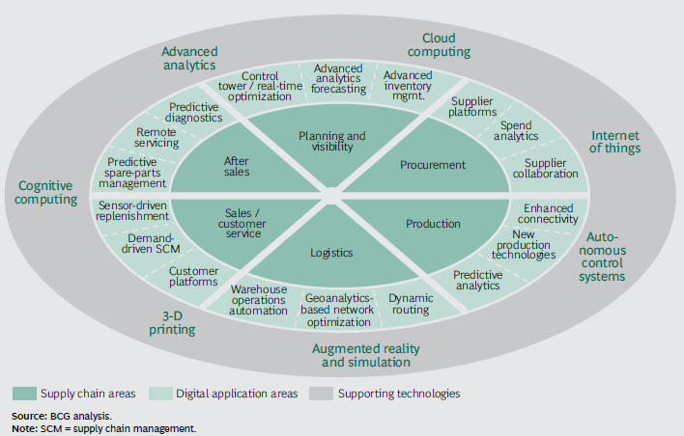
Landscape of Digital SCM

Slide 22
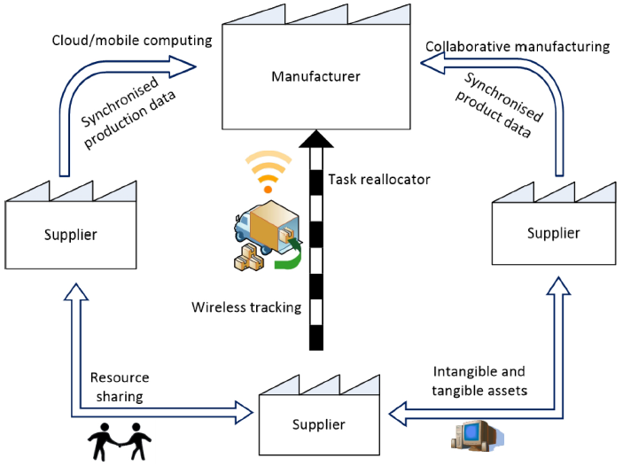
Internet 4.0 and Lean Production System

Slide 23
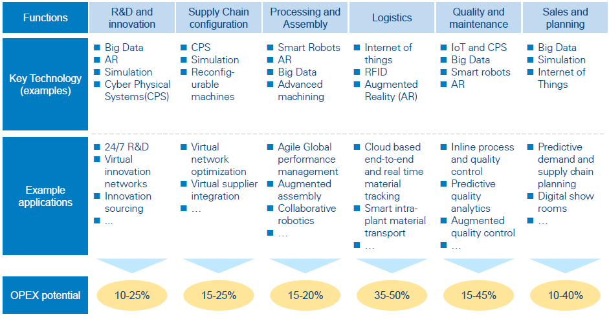
Operational Improvements

Slide 24
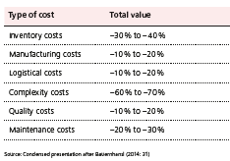
Reduction in costs

Slide 25
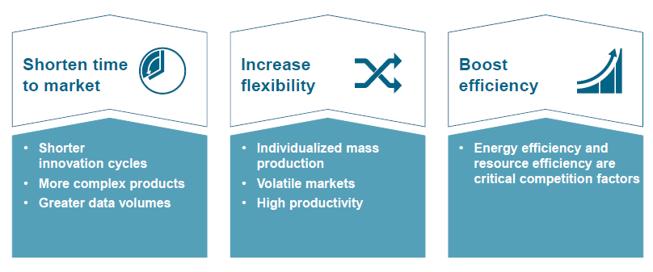
Other Potential Benefits

